Slide 1
Lesson 5 - Water’s Journey Home (Collection)
Farming & Our Food - A Grade 2 Water Cycle Unit
This lesson was created by Grain Farmers of Ontario to be used by Ontario educators in the classrooms. For any questions or concerns regarding use please contact bcurtis@gfo.ca

Slide 2
These lessons are designed to empower you in leading engaging, hands-on STEAM activities that directly connect with the Ontario Science curriculum. We understand that every classroom is unique, so each lesson offers a variety of options for implementation. Choose the approach that best suits your students and learning environment.
Notes:
Educator Notes:
This is the fifth lesson in the unit, completing the main stages of the water cycle.
The focus is on how water is collected after precipitation and its significance for farms.
Emphasize that water doesn't just disappear; it collects in various places.

Slide 3
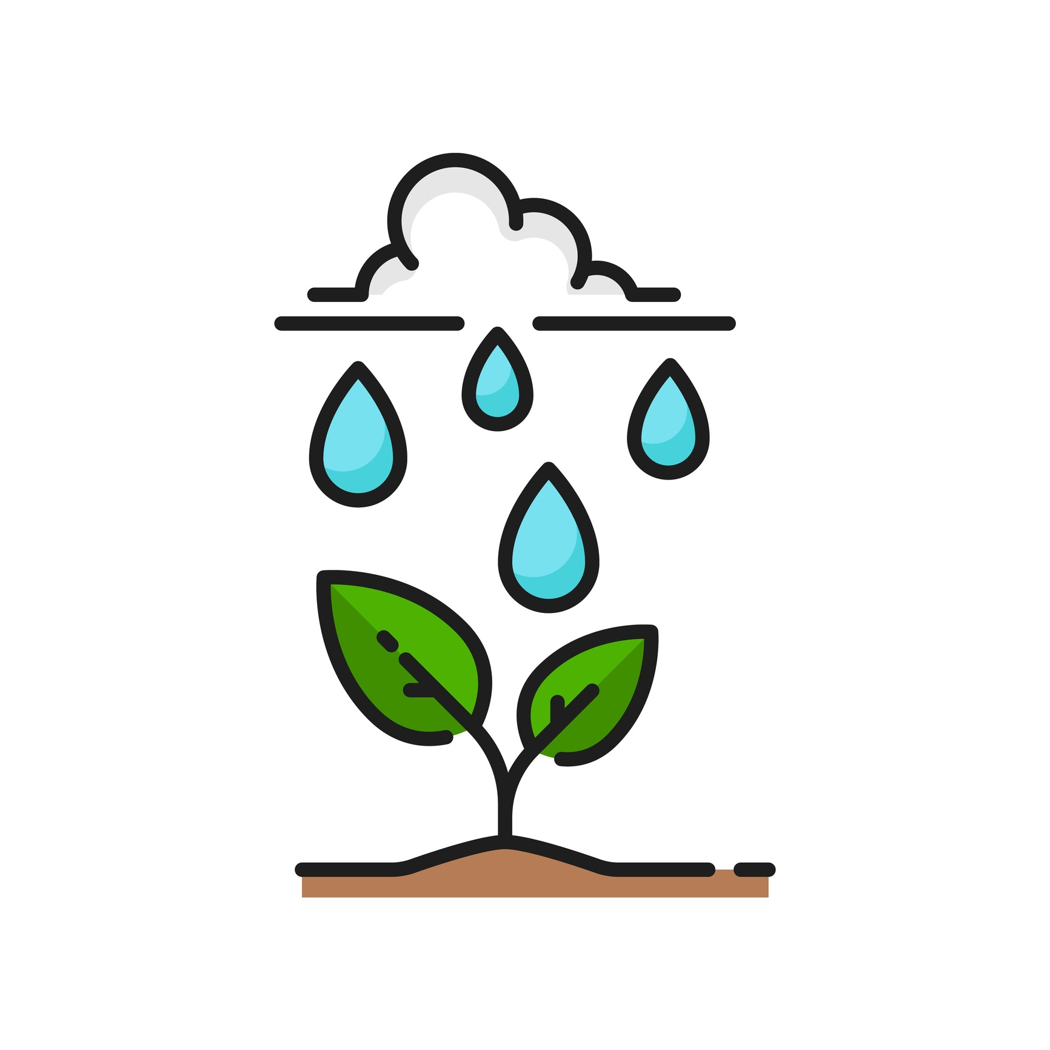
Lesson Overview
What We'll Explore: Where does the water go next?
Learning Goal:
Students will be able to explain how water collects in different places (e.g., rivers, lakes, groundwater, soil) after precipitation and its importance for farming.
Curriculum Connections:
Overall: E2. demonstrate an understanding of the properties of air and water, including water in various states, and of ways in which living things depend on air and water for their survival.
Specific: E2.3 describe the stages of the water cycle, including evaporation, condensation, precipitation, and collection.
Key Concepts:
Collection
Runoff
Groundwater
Surface water (lakes, rivers, ponds/dugouts)
Soil moisture
Notes:
Educator Notes:
Clearly state the learning objective for students.
Revisit the curriculum expectations, highlighting that this lesson covers the "collection" stage.
Reinforce that water collection is vital for all living things, especially farm crops and animals.

Slide 4
Materials & Activity
Getting Ready: Materials & Your Choices
General Materials Needed:
Chart paper or whiteboard, markers
Slide show
Option 1: Common Materials – Water Runoff Model
Focus: Demonstrating how water moves and collects on different surfaces.
Additional Materials: Large tray or cookie sheet, small blocks or books (to create a slope), spray bottle with water, various materials to represent surfaces (e.g., a sponge for soil, plastic wrap for hard ground, crumpled paper for hills).
Option 2: Slightly More Complex - Soil Absorption Race
Focus: Investigating how different soil types absorb and hold water for collection.
Additional Materials: Clear plastic cups (one per soil type), different soil types (e.g., sand, potting soil, clay soil), measuring cups, water, stopwatch (optional).
Notes:
Educator Notes:
Explain that teachers can choose the option that best suits their classroom resources.
Option 1 is a visual demonstration of runoff and collection points. Option 2 is a hands-on experiment about soil's role in water collection.
Emphasize observation and discussion for both activities.

Slide 5
Minds On
Notes:
(10 minutes)
Educator Notes:
Purpose: To activate prior knowledge and introduce the concept of water collection in various forms and locations.
Tips: Guide students to think beyond just evaporation for puddles. Connect to local bodies of water if applicable.
Farming Link: Immediately link water collection to the needs of crops and livestock on a farm.

Slide 6
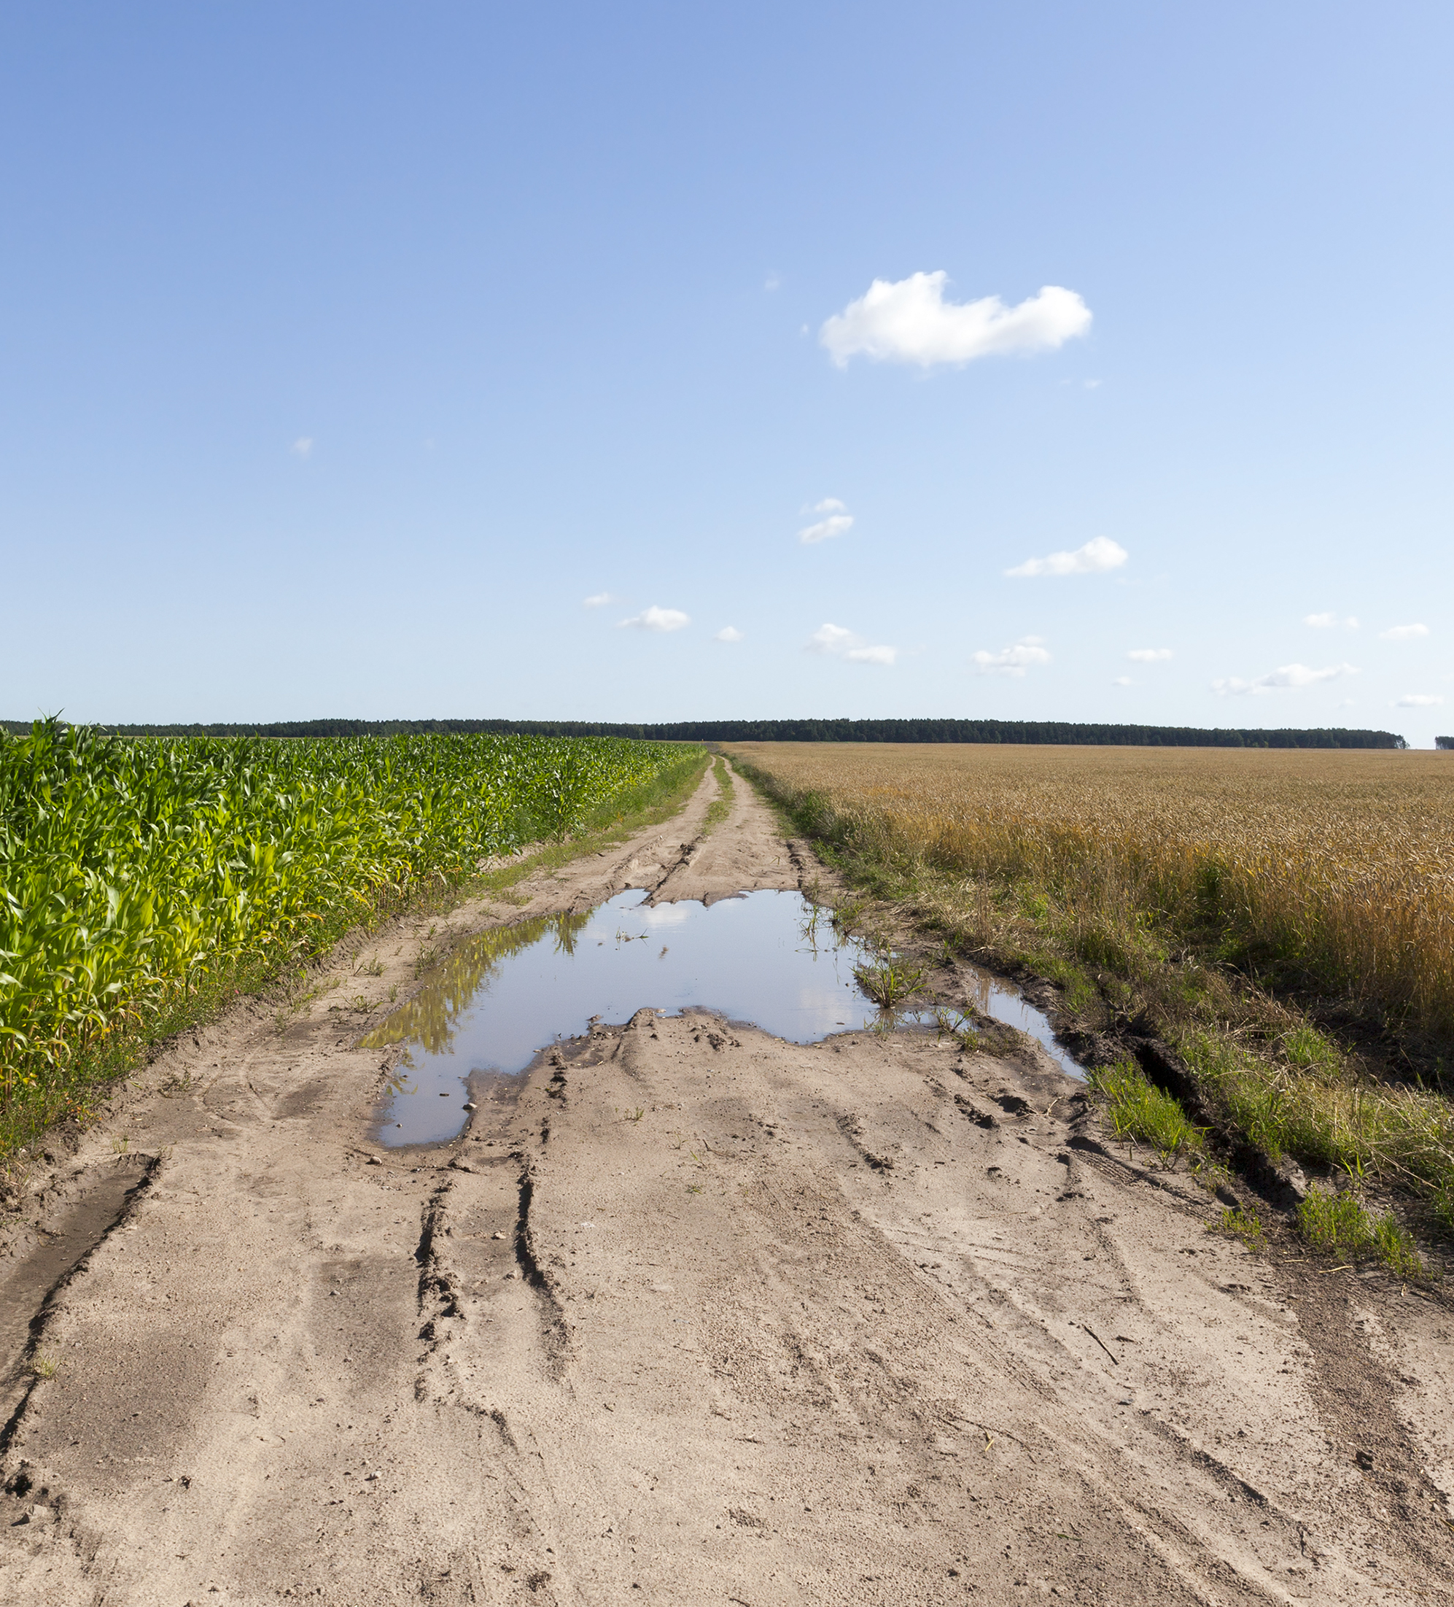
Where does the water go?
Notes:
Educator Notes:
Ask students: "We know some of this water will evaporate. But what else happens to the water in a puddle? Where does it go?"
Encourage students to brainstorm places where water collects after it rains (e.g., puddles, rivers, lakes, underground).

Slide 7
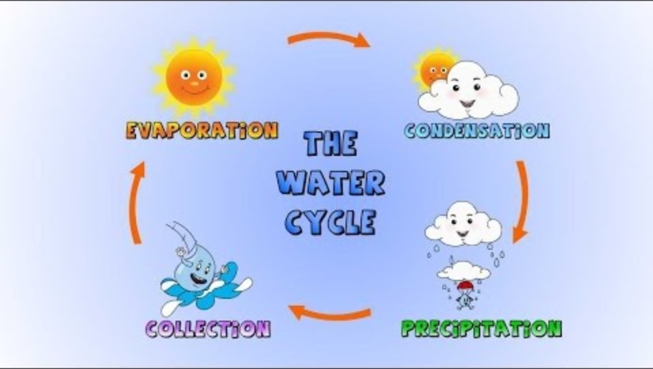
What is Precipitation?
Notes:
Educator notes:
This video is edited to focus only on the review of the water the water cycle and into collection. Introduce Collection: Explain that "collection" is the stage of the water cycle where water gathers in different places on Earth after precipitation.
Video source from: https://www.youtube.com/watch?v=s0bS-SBAgJI

Slide 8
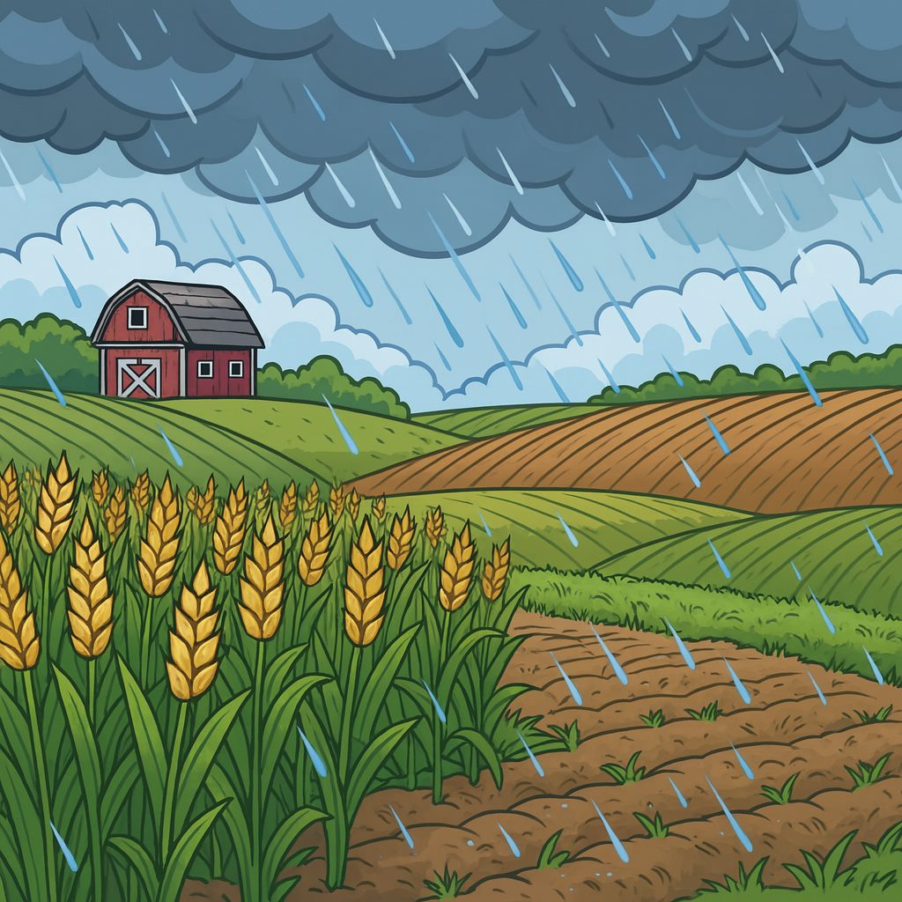
Why is it important for farmers that RAIN AND SNOW collect in places where their crops and animals can use it?
Notes:
Educator notes:
Some possible student answers might be: Plants need water from the soil, animals need water to drink, and farmers use collected water for various tasks.
Here is some more detail -
On a grain farm, farmers don’t want water to just pool anywhere—it can damage crops, drown roots, or delay planting/harvest. Instead, they try to manage where water collects and flows so it’s helpful, not harmful.
Here’s where they typically want water to go:
Low-lying collection areas (dugouts, ponds, wetlands, or retention basins): These hold excess water so fields don’t flood and can also serve as a water source for later use.
Drainage ditches or tile drainage systems: These guide water safely off fields while reducing soil erosion.
Grass waterways or buffer strips: These are planted in natural drainage paths so water collects and flows slowly, filtering out soil and nutrients before reaching streams or rivers.
Soil profile (in the root zone): Ideally, water infiltrates into the soil where crops can use it, rather than running off the surface.
So in short: farmers want water to soak into the soil where crops grow, and any extra to collect in managed areas like ponds, ditches, or wetlands—not sitting on top of fields.

Slide 9
Action

Slide 10
Option 1:
Water’s Path on a Farm
Notes:
(20-25 minutes)
Educator Notes:
Scaffolding: Encourage students to predict where the water will go on different surfaces.
Farming Connection: Directly link the model to real farm scenarios, emphasizing the importance of soil as a natural water collector and the use of dugouts/ponds.
Trusted Resources for Water Collection and Farming:
Canadian Food Focus. "Water: The Most Precious On-Farm Natural Resource." (Source: https://canadianfoodfocus.org/on-the-farm/water-the-most-precious-on-farm-natural-resource/) - This resource discusses dugouts and soil moisture retention.
Ontario.ca (Ministry of Agriculture, Food and Agribusiness). "Water management in agriculture." (Source: https://www.ontario.ca/page/water-management-agriculture) - General information on water sources for agriculture.

Slide 11
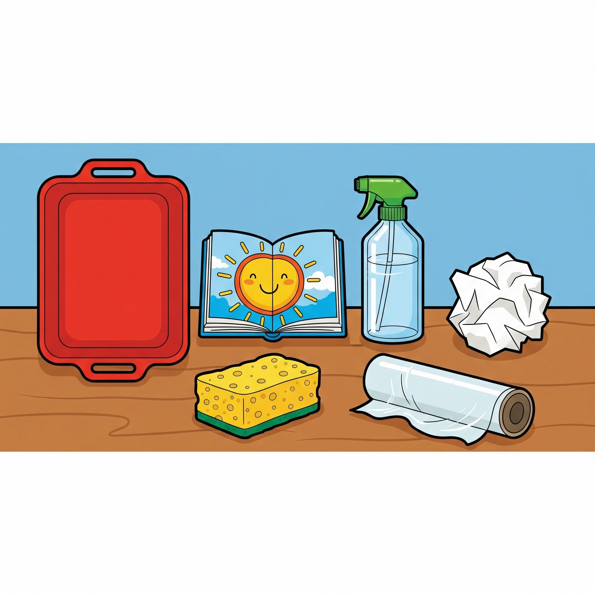
Step 1: Our Water Runoff Experiment
Check your materials:
A large tray or cookie sheet
A small block or book to make a hill
A bottle of water with a spray top (a spray bottle)
Things to be our "land":
  A sponge (for soil)
  Plastic wrap (for hard ground)
  Crumpled paper (for hills)
Notes:
Educator Notes:
Students can work in small groups or this can be a whole class experiment.

Slide 12
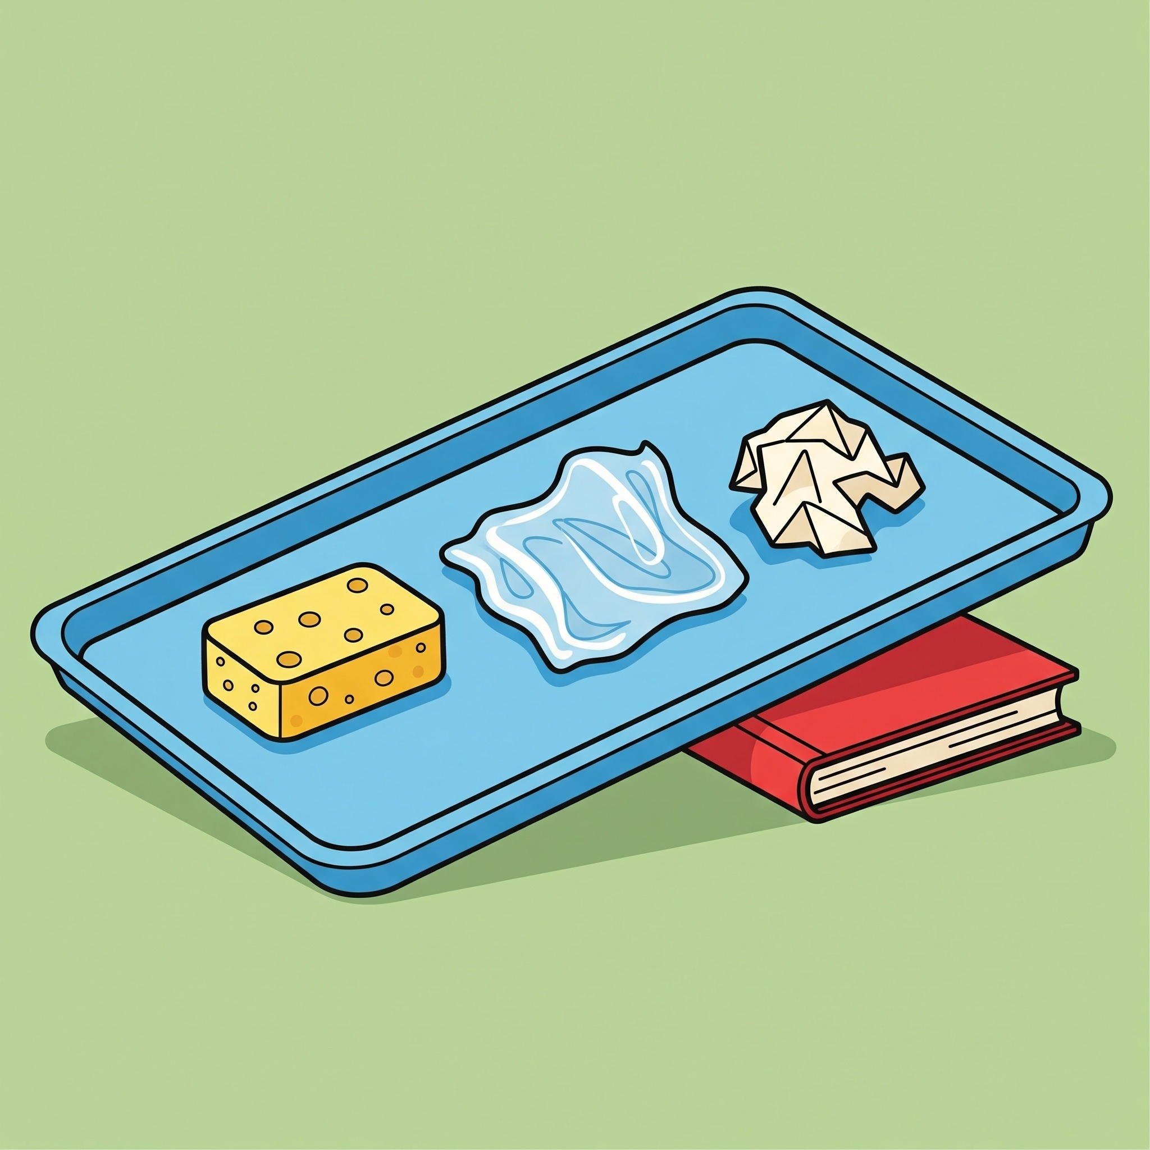
Step 2:
Let’s make our hill
Use a small block or book to make your tray a little slanted, like a hill.
Place your different "land" materials on the tray (sponge, plastic wrap, and crumpled paper).
Notes:
Educator Notes:
Set Up Runoff Model: Have students or small groups set up a large tray on a slight slope (using blocks or books).
On the tray, place different materials: a sponge (for healthy soil), plastic wrap (for hard ground/roads), and crumpled paper (for hills).
Have students spray water onto the "land" with a spray bottle, simulating rain.

Slide 13
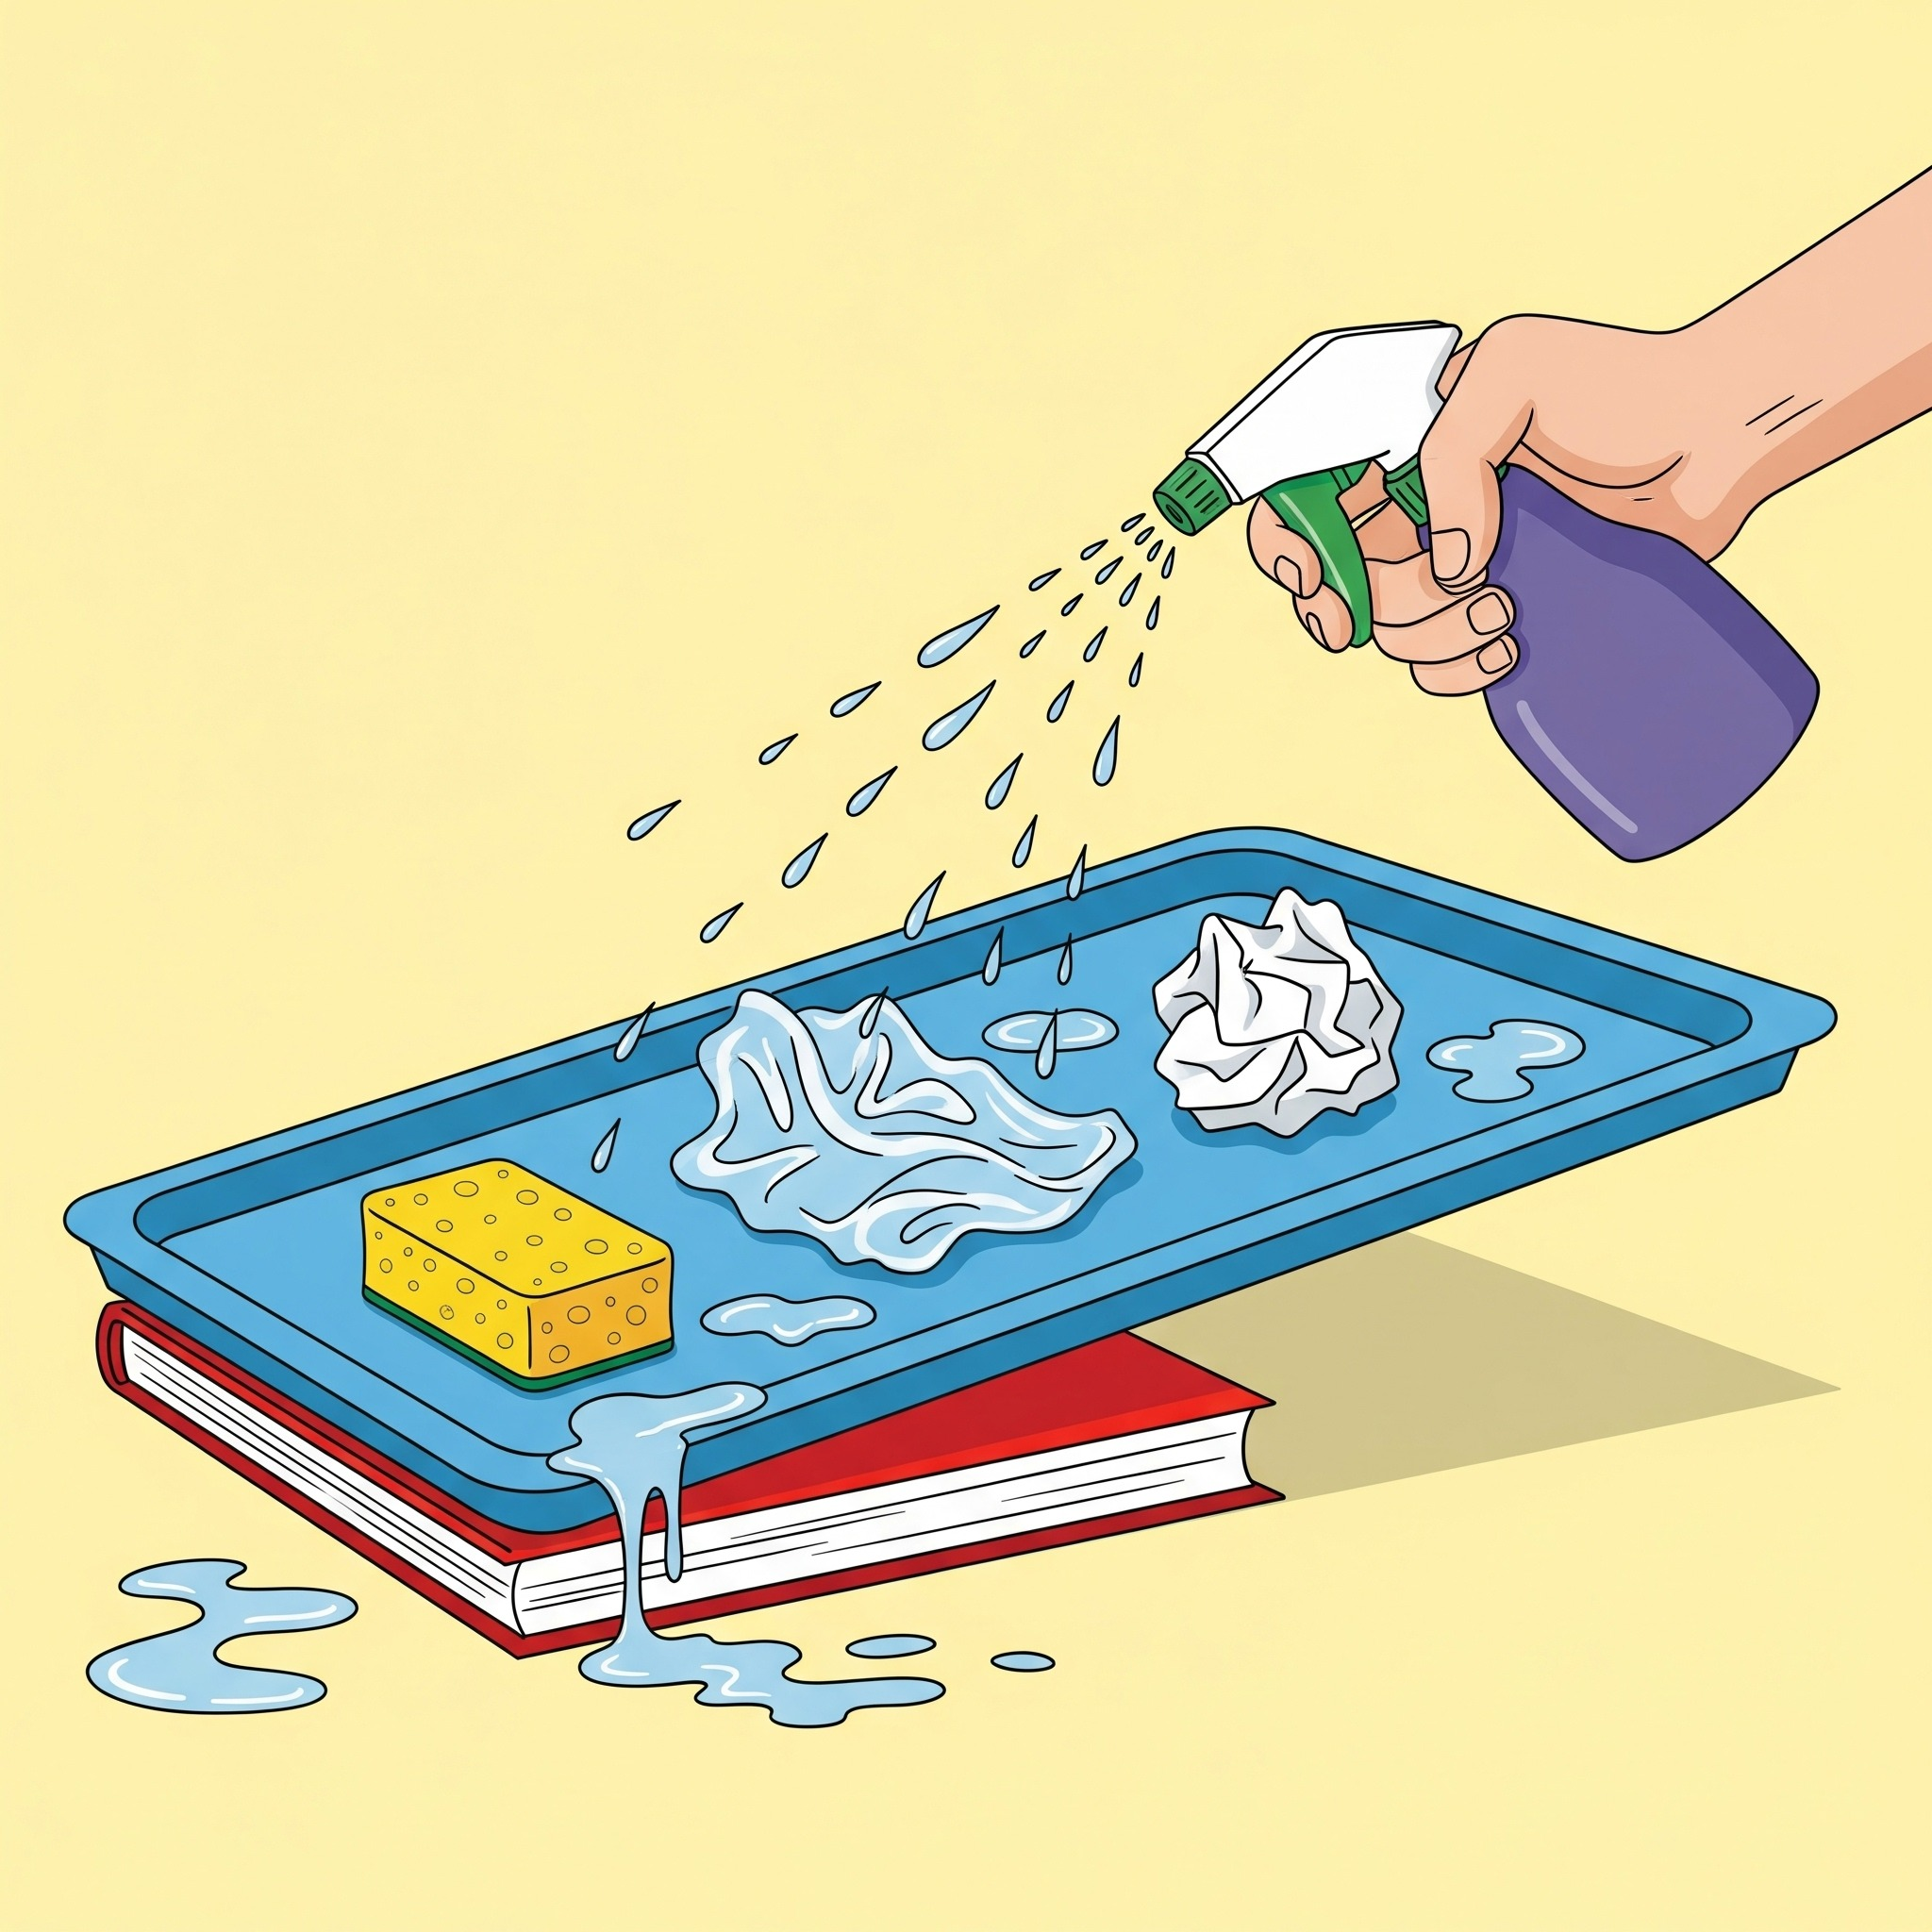
Step 3:
Let’s make it rain
Use the spray bottle to spray water all over your "land.“
Don't stop until you see what happens.
Notes:
Educator Notes:
Have students spray water onto the "land" with a spray bottle, simulating rain.

Slide 14
Step 3:
Watch closely!
What happens on the sponge?
What happens on the plastic wrap?
Where does the water go?
Notes:
Educator Notes:
Observe & Discuss Collection:
"Watch where the water goes! Does it soak in? Does it run off? Where does it collect?"
Point out how water runs off hard surfaces but soaks into the sponge.
"Just like on a real grain farm, some rain soaks into the soil (more is absorbed if the soil is healthy), and some runs off into ditches, streams, or ponds."

Slide 15
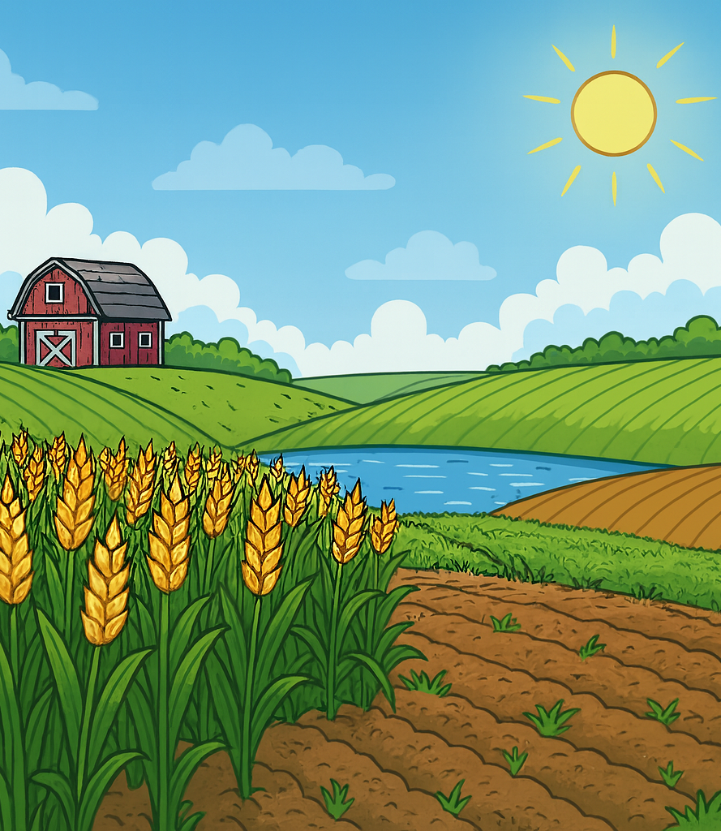
Farming Connection
How do farmers use different sources of COLLECTED WATER?
Notes:
Educator Notes:
Farming Connection:
Soil Moisture: "The water that soaks into the soil is super important for grain plants, like corn and wheat, to drink through their roots!"
Ponds/Dugouts: "Sometimes farmers have special ponds called 'dugouts' on their land to collect rainwater for their animals to drink, or even to water crops if it's very dry."
Rivers/Lakes: "Water also collects in bigger places like rivers and lakes, which can be important for farms nearby."
Resources:
https://ontariograinfarmer.ca/2020/10/01/water-management-3/
A great resource for educators to support understanding of water collection by grain farmers in Ontario

Slide 16
Option 2:
Soil Absorption Race
Notes:
Educator Notes:
(20-25 minutes)
Scaffolding: Encourage students to make hypotheses and record simple observations.
Preparation: Ensure cups have small drainage holes at the bottom to observe water retention vs. drainage.
Farming Connection: This activity directly links soil properties to water collection and retention, which is crucial for grain farming. It highlights how farmers manage their land to optimize water availability for crops.
Trusted Resources for Soil and Water Collection:
Grain Farmers of Ontario / Good in Every Grain. "Sustainability on the Farm." (Source: https://gfo.ca/market-development-and-sustainability/sustainability-on-the-farm/) - Discusses soil health, organic matter, and water retention.
Canadian Food Focus. "Water: The Most Precious On-Farm Natural Resource." (Source: https://canadianfoodfocus.org/on-the-farm/water-the-most-precious-on-farm-natural-resource/) - Discusses soil moisture.

Slide 17
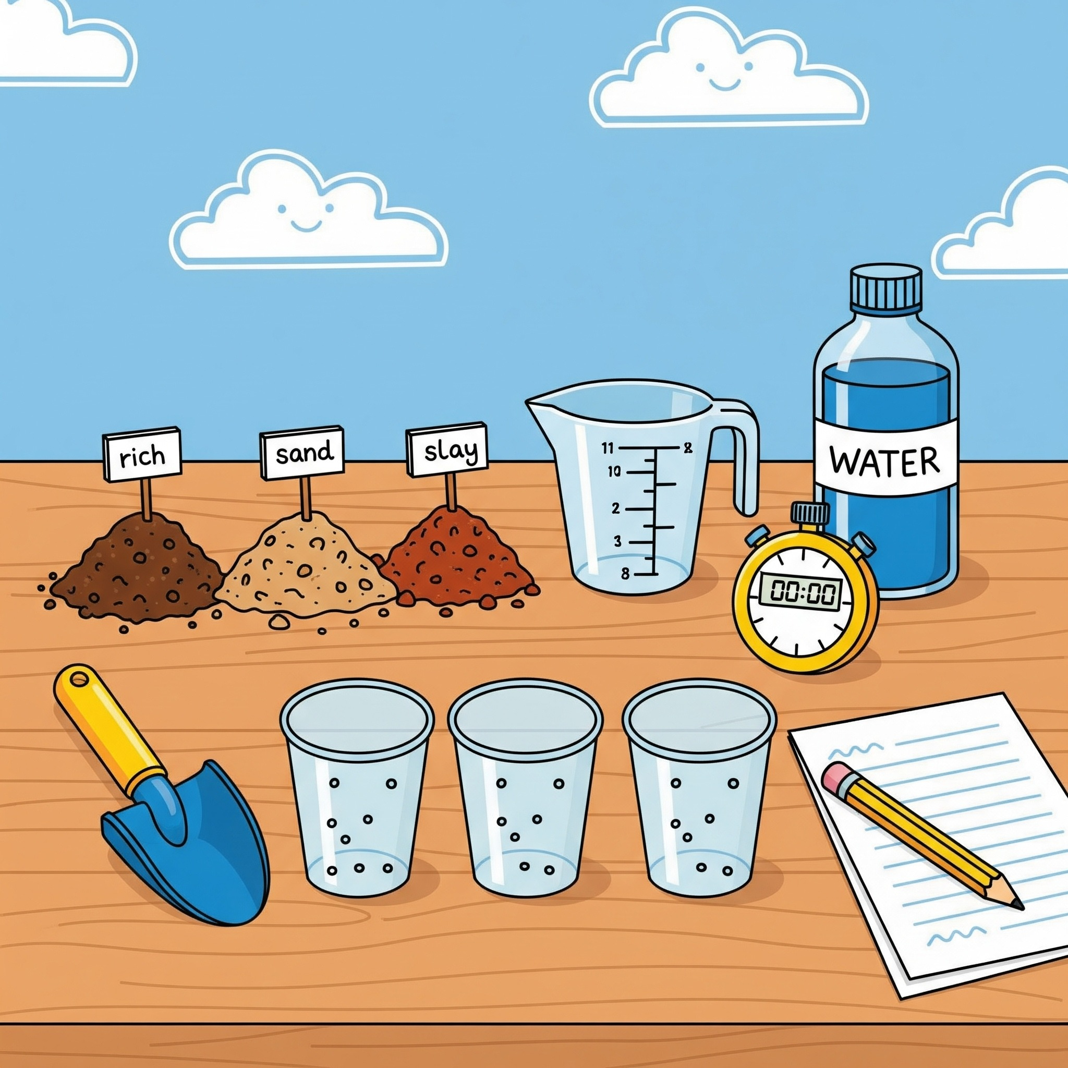
Step 1:
Let the races begin
Check your materials:
3 clear plastic cups (the cups need small holes in the bottom for water to drain)
A scoop or small shovel
3 different types of soil
Measuring cup
Water
A clock or a stopwatch (optional)
Pencil and paper for observations (optional)
Notes:
Educator Notes:
This race can be done as a whole group or in small groups.
Three types of soils:
Sand: You can get this from a sandbox or a hardware store.
Potting Soil: This is easy to find at a garden center or from the local dollar store.
Clay Soil: You might find this in a garden bed, or you can buy it in a bag.
Rocks: You might get this in your playground or from the local dollar store.
You might also include a whole class timer found on YouTube or provide students with a stopwatch
Students could record their observations (using pencil and paper) or observe and discuss

Slide 18
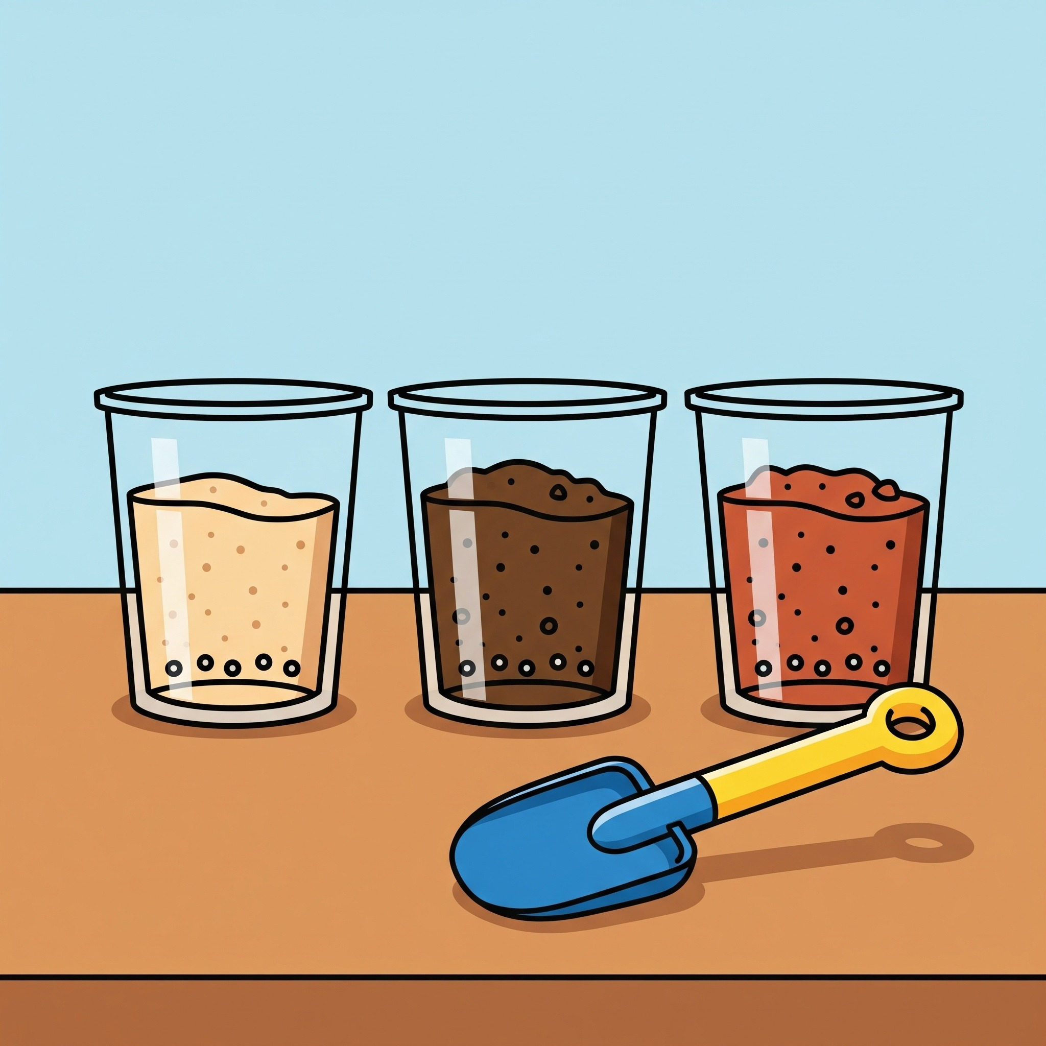
Step 2:
Cup set up
Set Up Your Cups:
Put one type of soil in each of your three cups.
Use the scoop to make sure you have the same amount of soil in each cup.
Notes:
Educator Notes:
Set Up Soil Absorption Experiment: Divide students into small groups. Provide each group with three clear plastic cups, each filled with a different type of soil (e.g., sand, potting soil, clay soil).
Have students predict which soil will absorb water the fastest and hold the most water.
Have them pour the same measured amount of water (e.g., 1/2 cup) into each cup simultaneously.

Slide 19
Step 2 Continued:
Cup set up
Make a Prediction: Look closely at the three cups:
Which soil do you think will absorb the water the fastest?
Which one will hold the most water?
Talk about your predictions with your group.
Notes:
Educator Notes:
Set Up Soil Absorption Experiment: Divide students into small groups. Provide each group with three clear plastic cups, each filled with a different type of soil (e.g., sand, potting soil, clay soil).
Have students predict which soil will absorb water the fastest and hold the most water.
Have them pour the same measured amount of water (e.g., 1/2 cup) into each cup simultaneously.

Slide 20
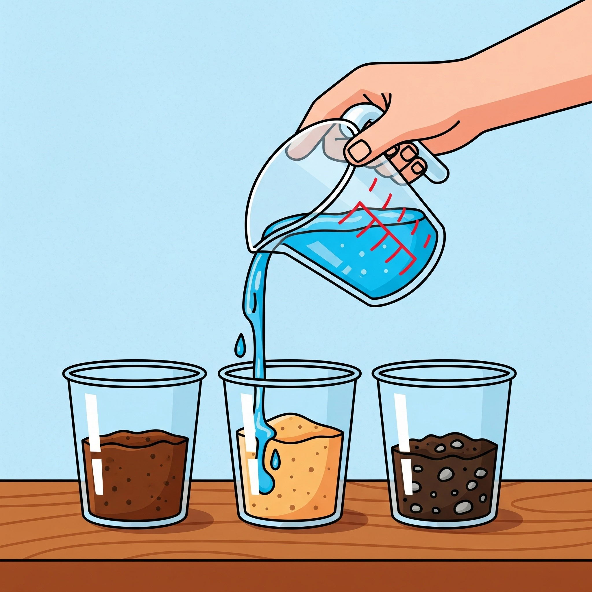

Step 3:
Start the race!
Use the measuring cup to pour the exact same amount of water into each cup at the same time.
Watch Closely: As the water goes in, watch what happens.
Is the water soaking in or is it draining out the bottom right away?
Use your clock or stopwatch to see which cup finishes its "race" first.
Notes:
Educator Notes:
Pour and observe:
Have them pour the same measured amount of water (e.g., 1/2 cup) into each cup simultaneously.
Students observe how quickly the water disappears into each soil type and how much water drains out the bottom (if cups have holes). They can time it or simply observe.
Video link for timer: https://www.youtube.com/watch?v=MDk6V-B4Qhw&t=33s

Slide 21
Step 4:
What happened?
Which soil was the fastest?
Which one held on to the water the best?
Why do you think that happened?
Notes:
Educator Notes:
Discuss & Record (optional):
Discuss: "Which soil soaked up the water fastest? Which one held onto the water best?" (Sandy soil drains quickly, clay/potting soil holds more water).
More resources:
https://goodineverygrain.ca/2018/10/04/cover-crops-101/ (scroll down to see a real life erosion of this water flow test).

Slide 22
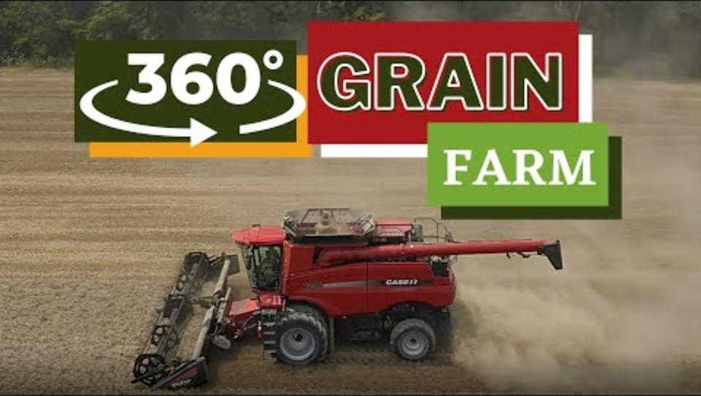
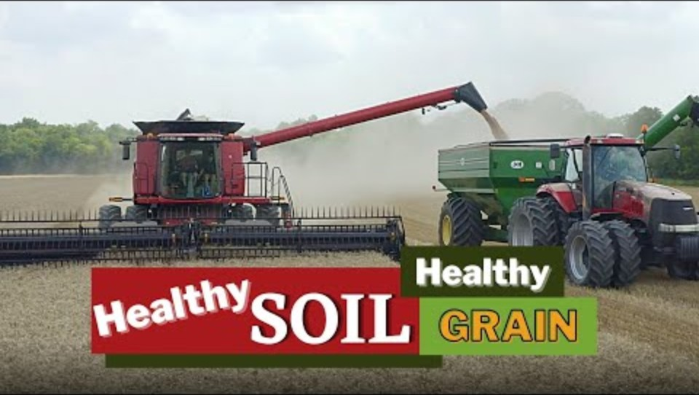
Farming Connection
Notes:
Educator Notes:
Farmer's Soil Choices:
"Grain farmers know their soil very well! They understand that different soils collect and hold water differently."
"Farmers might add special things to their soil, like compost, to help it act more like a super-sponge, so it can collect and hold more water for their grain crops."
"This helps make sure the plants have enough water to drink, even after the rain stops and the water has collected in the soil!"
Video 1: This is a 360 video that explains what they do to keep their soil healthy. This is a great resource to show students how farmers take care of their land. https://www.youtube.com/watch?v=VlHjM6jgnqg&t=128s
Video 2: The video is a great resource featuring Ontario grain farmers Kyle and Julie. It provides a good explanation of how farmers keep their soil healthy and how it affects the crops. https://www.youtube.com/watch?v=zhU5lnHIbHY&t=14s
More videos can be found at: https://goodineverygrain.ca/2022/01/10/virtual-360-degrees-grain-farm-tour/

Slide 23
Consolidation

Slide 24
Let’s review the WATER CYCLE
Notes:
Educator Notes:
Use this video to review all that has been covered so far from the water cycle. Ask students: "Now, where does the water go after it precipitates?"
Video link: https://www.youtube.com/watch?v=s0bS-SBAgJI

Slide 25
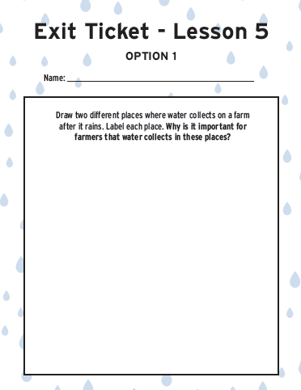

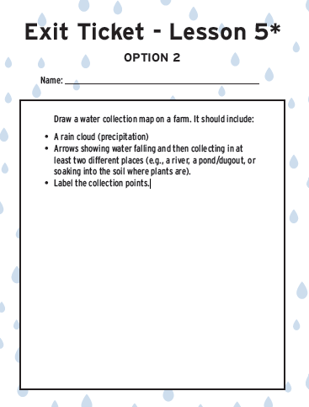
Show what you know:
Notes:
Educator note:
Educators, you have a few options here to choose what is best for your students. Use the provided Lesson 5 exit ticket (can be downloaded from https://goodineverygrain.ca/2026/01/06/water-on-farms-a-six-lesson-unit-for-grade-2/ ) or have students record their answers in their notebooks, on a sticky note, or on a piece of paper.
Have students draw two different places water collects on a grain farm. Have students label each place and answer the question, Why is it important for farmers that water collects in these places?
Advanced option (marked with a * on Lesson 5 exit ticket): Have students draw water collection on a farm, and drawing should include the following elements:
Rain cloud (precipitation)
Arrows showing water falling and then collecting in at least two different places (e.g., a river, a pond/dugout, or soaking into the soil where plants are).
• Label the collection points.

Slide 26

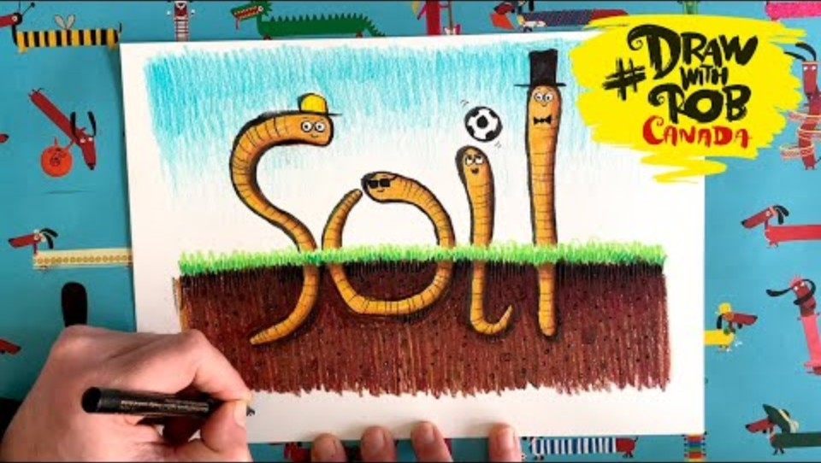
Want More?
Check out these sources and resources to further dive into water and farm
Notes:
Educator Notes:
Video source for Right This Very Minute by Lisl H. Detlefsen: https://www.youtube.com/watch?v=yKkQ_P_ZMr4
This read aloud supports students connection the food they eat to the farmers who grow it, often touching on the importance of natural resources like water.
Drawing Worms: https://www.youtube.com/watch?v=wg-jCM4v7Kc&t=621s Also found on the Good in Every Grain Site: https://goodineverygrain.ca/draw-with-rob-ep-2/
This is a fun video that supports students in drawing wiggly worms and further understanding soil health.

