Slide 1
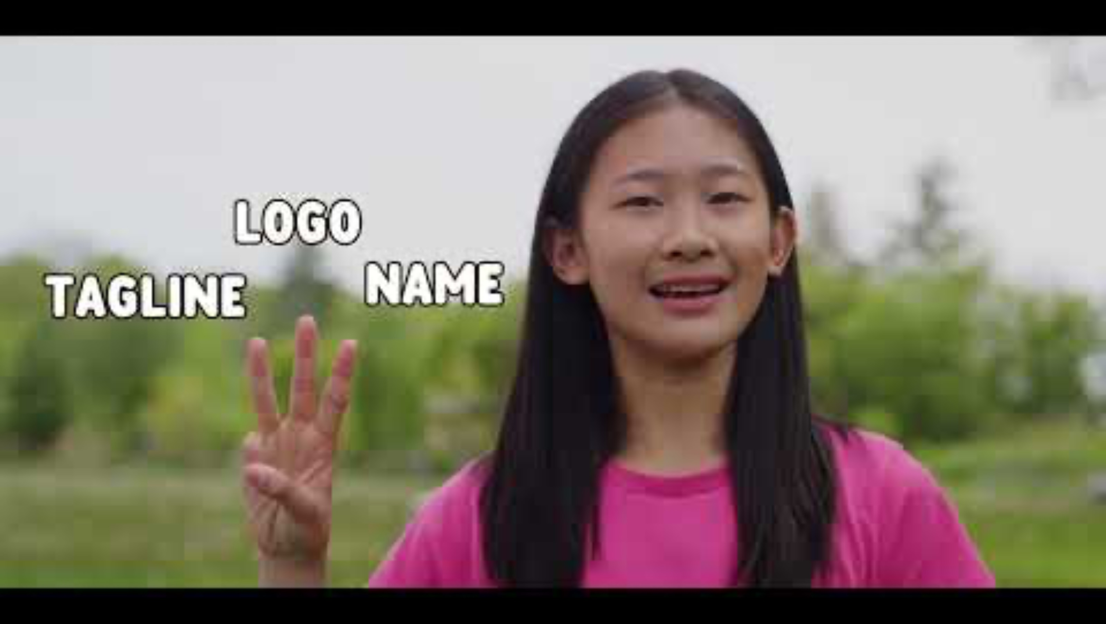
A Note to Teachers
There is only one goal of this stage – to kick off the STEMterprise project.
Students will learn about entrepreneurship to help them meet the challenge of creating a new granola bar business.
This lesson encourages students to connect curiosity with the qualities of a successful entrepreneur. Consider showing them our new video to spark their excitement!

Slide 2
Expectations
Transferable Skills: Innovation, Creativity, and Entrepreneurship
develop concepts, ideas, or products for the purpose of contributing innovative solutions to economic, social, and environmental problems
demonstrate leadership, initiative, imagination, creativity, spontaneity, and ingenuity
Ontario Science & Technology Curriculum Strand B Life Systems
B1.1. Begin to consider ways in which plants are important
Agriculture/Agri-Food Themes
Begin to understand where food comes from

Slide 3
Stage 1
Lesson 1: The Challenge
© The National Farmers’ Union of England and Wales - All rights reserved. These resources may be reproduced for educational use only.

Slide 4

Learning Goals
Learn about the STEMterprise Challenge!
Understand what an entrepreneur is and what character traits are important
Think about what we need to learn to be successful in our businesses

Slide 5
The Challenge!
Notes:
The Challenge!
[Note to teachers] This slide is meant to kick off the granola-bar challenge for students. Students will get excited about this project.
Set the scene: Ontario children are bored with their current snack choices. They need an exciting, innovative new option. In this project, they will design a brand-new granola bar to fuel our bodies for learning!
Explain: Students will learn how to set up a granola bar business. Perhaps they will grow up to become entrepreneurs with businesses of their own!
Step one is to understand what an entrepreneur is and to accept the challenge.

Slide 6
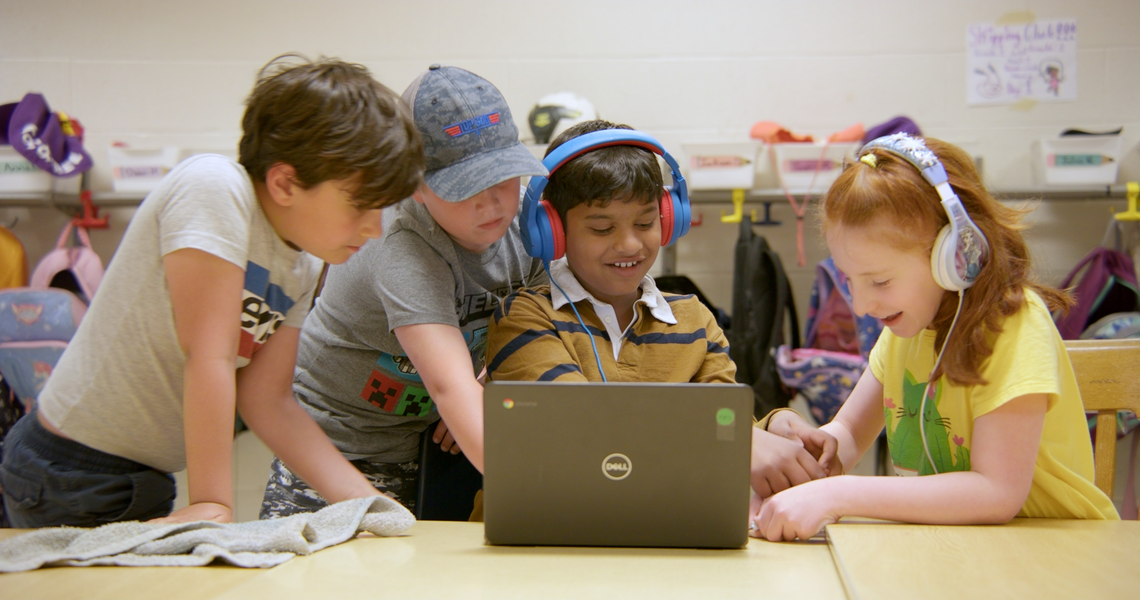
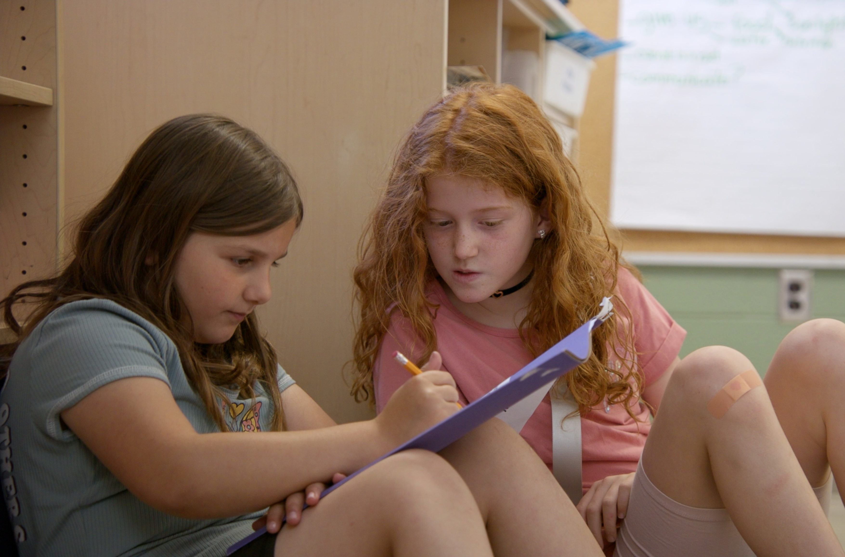
STEMterprise Students
Students across Ontario are taking on the challenge!
Notes:
STEMterprise Students
Explain to students that they are one of hundreds across Ontario doing the challenge!

Slide 7
STEMterprise PLEDGE
Today I will do my best to be MY best.
I promise my business group and myself to use my curiosity to be innovative.
I am ready to experiment with new learning and share ideas with my group.
I won’t give up.
If I fail, I will use what I learned to help the group reach our goal.
Notes:
STEMterprise PLEDGE
Students can stand and say this pledge together, or you can revise it as makes sense for your group. This is intended to be a starting point.
You may wish to print the pledge and have students sign them, then post them around the classroom as a reminder. A PDF of this pledge with room group signatures is available on the STEMterprise website.

Slide 8

What is an Entrepreneur?
STEMterprise will help you meet the challenge by becoming entrepreneurs!
What does it mean to be an Entrepreneur? Read along to find out!
Notes:
What is an Entrepreneur?
Tell Students - You will get to become an entrepreneur! Has anyone heard that word before? What do we think that might mean?
Let’s read a book to learn about what being an entrepreneur is all about.
Watch the video – https://www.youtube.com/watch?v=ZhJ0aVOnC_Y

Slide 9
Character Traits
What are the characteristics of a successful entrepreneur?
Notes:
Character Traits
An entrepreneur is someone who starts a new business. Do you know any entrepreneurs? (class discussion)
What are the characteristic of a successful entrepreneur? (class discussion)
Tip! Use this slide to record the class discussion. This works especially great when it’s projected on a white board. An extra slide follows with a few ideas…
Hints: Determination, Self-discipline, Self-awareness, Curiosity, Optimism, Passion, Decisive, Flexibility and adaptability, Willingness to take risks, Unafraid of failure, Innovative, Focused

Slide 10
Character Traits
What are the characteristics of a successful entrepreneur?

Slide 11


Action: Wonder Wall
Entrepreneurs are curious!
What do you wonder about granola bars or about the business of making and selling them?
Write your questions and add them to our WonderWall.
Notes:
Wonder Wall
Explain to students - One of the first steps of starting a business is to ask a lot of questions and to research and learn as much as you can about the product you are going to create.
Ask students to consider what they would like to know granola bars and where their ingredients come from.
Ask them to write down their question(s) and add it to the Wonder Wall or in their notebooks. Explain that we will answer their questions during the project.
Hint: Encourage students to begin thinking about where their food/ingredients come from and the multiple aspects of starting up a business (brands, logos, pricing, market, competition, etc.)

Slide 12
Today’s lesson made me feel _________ because…

Slide 13
Check In – What’s Next?
I’m envisioning a road map of the stages and a “you are here” icon maybe kind of like this.

