Slide 1
Stage 10 – Bake Sale
© The National Farmers’ Union of England and Wales - All rights reserved. These resources may be reproduced for educational use only.

Slide 2
Learning Objectives
Set up a farm store.
Present a business experience.
Calculate with money and give change.
Notes:
Learning Objectives
Set up a farm store.
Present a business experience.
Calculate with money and give change.

Slide 3
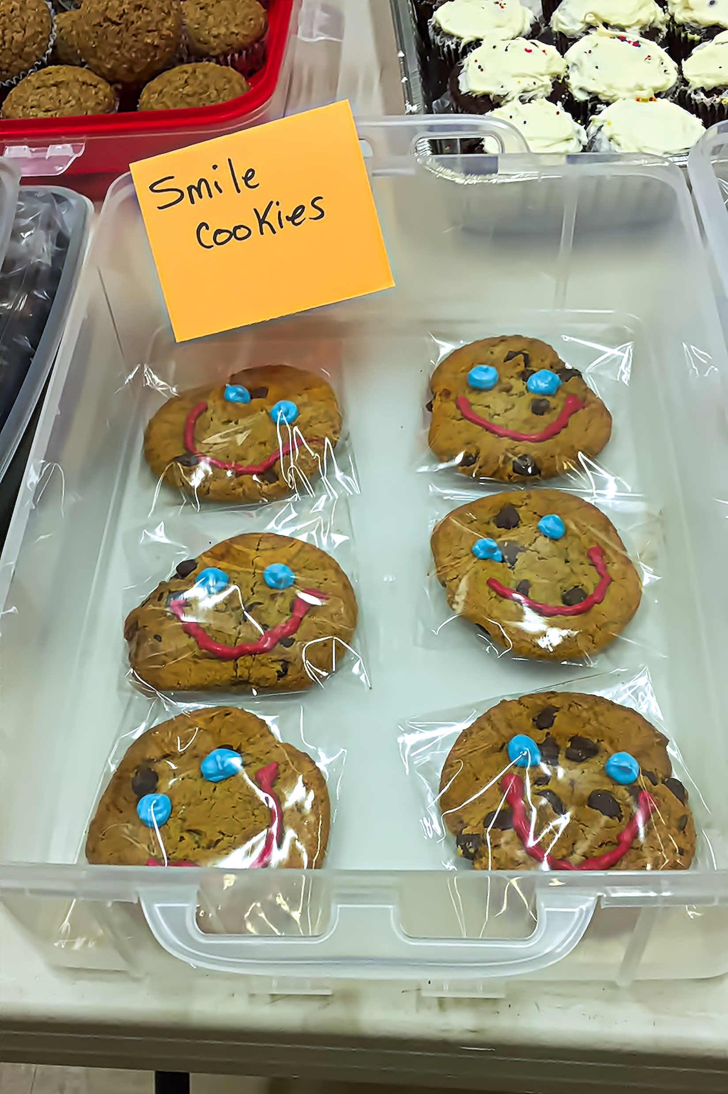
Bake Sale!
How should we set up the classroom for the bake sale?
How will your group present your work and your granola bars on your table?
Notes:
Bake Sale!
Ask students to arrange the classroom like a market or bake sale so each table represents a farm store with the children’s advertising and photos of their products clearly displayed.
Have examples of the children’s projects available for visitors to read. This could be presented in their notebooks or as a poster or portfolio of work completed during the project.

Slide 4
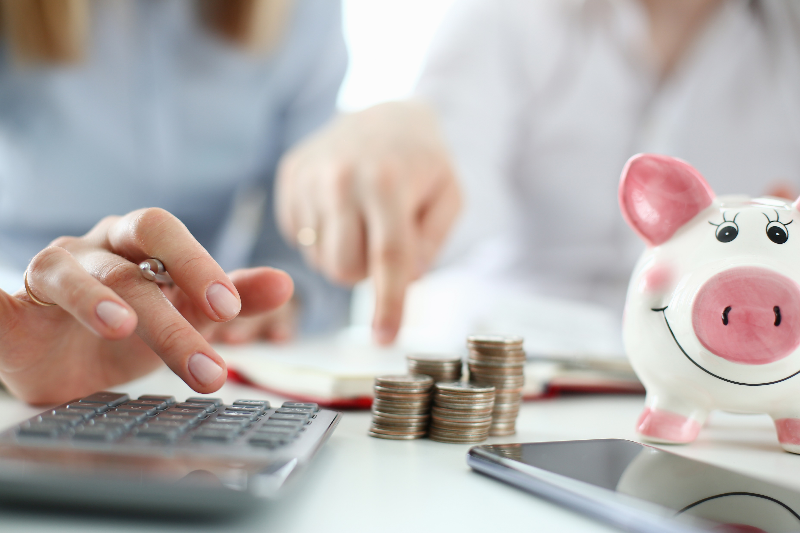
Calculating with Money
You sell 3 granola bars for 30¢ each. What is the total?
You sell 2 boxes of granola bars for $1 each, and 1 granola bar for 40¢. What is the total?
You sell 1 box for $1.20 ($1 + 20¢) and 2 single granola bars for 30¢ each. What is the total?
Notes:
Calculating with Money
Model the method you would like students to use for calculating change.
Distribute the play money and split the class in half so they can experience being a seller and a customer.
The customer group will visit their peers’ shops and place orders they will pay for with their play money. They must ensure that they have enough money to pay for their orders.
The seller group will welcome their customers to their farm stores, calculate the total cost of their orders, and give back change.
Once the customer group has spent all their play money, switch the groups and repeat the activity to give everyone the opportunity to experience both budgeting and calculating order totals and change.
Once everyone has practised giving change, the bake sale can begin, and students can share their learning with the invited guests and sell them their innovative new granola bars.

Slide 5
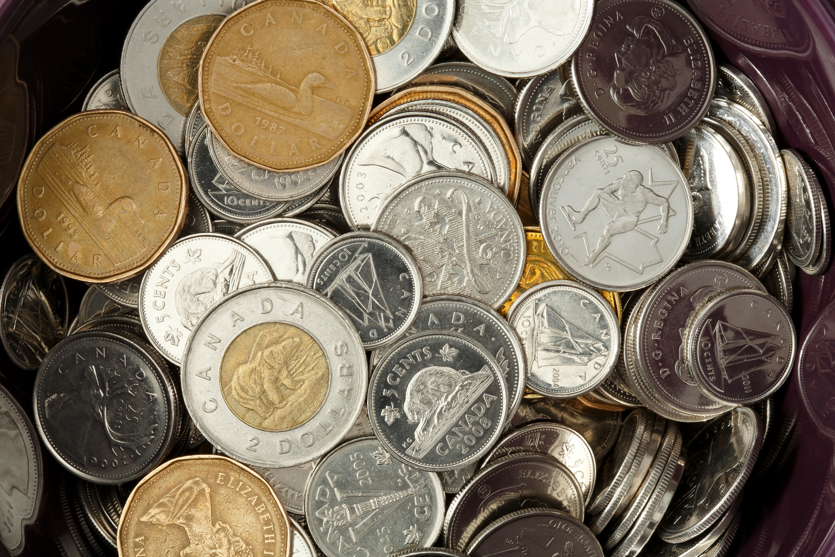
More Practice
A customer spends 75¢ and pays with a loonie ($1). How much change should you give them?
A customer spends 45¢ . They pay with 2 quarters (25¢ each). How much change should you give them?
A customer buys 4 bars for 10¢ each. They pay with 1 quarter (25¢) and 2 dimes (10¢ each). How much change should you give them?
Notes:
More Practice
A customer spends 75¢ and pays with a loonie ($1). How much change should you give them?
A customer spends 45¢ . They pay with 2 quarters (25¢ each). How much change should you give them?
A customer buys 4 bars for 10¢ each. They pay with 1 quarter (25¢) and 2 dimes (10¢ each). How much change should you give them?

