Slide 1
Stage 9 - Market Your Product
© The National Farmers’ Union of England and Wales - All rights reserved. These resources may be reproduced for educational use only.

Slide 2
Learning Objectives
Decide on a selling price.
Calculate profit.
Promote a food product.
Notes:
Learning Objectives
Decide on a selling price.
Calculate profit.
Promote a food product.

Slide 3
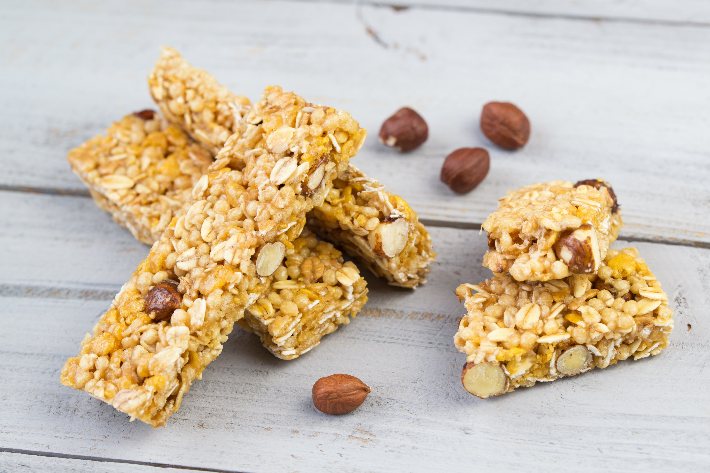
Selling Price
We need to charge enough to pay for making each bar but not so much people will not buy it!
Example: if it costs $1 to make each bar, we need to charge more than $1 to make a profit.
Profit is the money left over after you pay your expenses.
Decide on a selling price.
Subtract the cost of ingredients.
What is left is your profit.
Notes:
Deciding on a Selling Price
Explain: this is an exciting stage; it is the day they will prepare to sell their products. First, we need to decide on a selling price.
• Ask students to discuss in groups what they think we need to consider to decide on a selling price (i.e., consider how much the ingredients cost, making the price affordable so customers want to buy it but not so low they cannot cover their costs).
Explain: if it costs $1 to make each granola bar, then your selling price needs to be more than $1 so you make a profit.
Profit is the money left over after you have covered the costs of making the product.
Provide students with the average cost of their bars based on what the class’s shopping cost. You may need to tweak it to make the numbers simpler to work with.
Ask students to decide on a selling price and then subtract to work out how much profit they will make for each bar they sell. Model the subtraction calculation method you would like them to use, if necessary.
Lead a conversation about what should be done with the money raised. There might be a local charity the students like or the money raised could be used to fund the project next year.

Slide 4
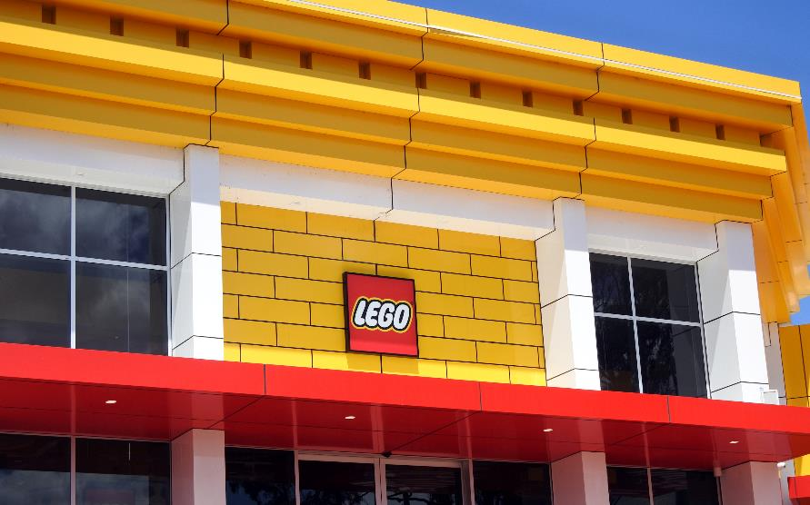
Promote Your Product
Promotion means telling people about your product. Businesses promote their products.
Promotion is used to advertise what is good about the product and why it is better than similar products.
Use promotion to tell customers why they should buy your product.
How can your businesses promote your product?
Notes:
Promote Your Product
Share the definition of promotion and ask the children to think of real-life examples they have seen.

Slide 5
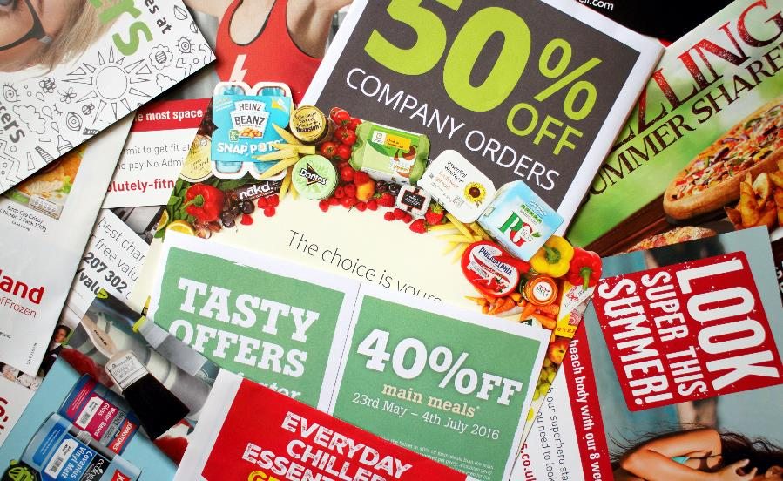
Method of Promotion
Advertising: magazine ads, posters, flyers, brochures, radio and TV ads, YouTube ads, and social media.
Special offers: price reductions, competitions, and free samples.
Endorsements by celebrities or people who like your product.
Notes:
Methods of Promotion
Share the definition of promotion and ask the children to think of real-life examples they have seen.

Slide 6
Food Advertising
Look at the food advertising.
How do they encourage customers to buy more of their products?
What makes you want to buy it?
Notes:
Exploring Food Advertising
Give students a selection of food advertisements from magazines, flyers, or the Internet. Have them examine what the businesses have done to persuade customers to buy their product. Do they think it works? Would they be persuaded? How does the ad use photographs and persuasive language?

Slide 7
Promoting Your Product
Design a poster, flyer, or brochure to promote your product. Think about how to appeal to customers and get them to buy your product. You may want to include price, food miles, and nutritional benefits.
How is your granola bar better than the bar your competitors make?
Think about any special offers you can use on your advertisement. For example, “Buy one, get one FREE!”
Notes:
Promoting Your Product
Ask students to take inspiration from the promotional material they have examined to design their own written advertisement for their product.
Remind them to describe/explain how their product is better than their competitors’ products.
Remind them to include the price, food miles, and nutritional benefits they researched in stage 7.
Remind them to include the price and special offers (e.g., lower introductory price, buy one get one free).
Programs such as Adobe Express, PicCollage or Canva could be used for this task.

Slide 8
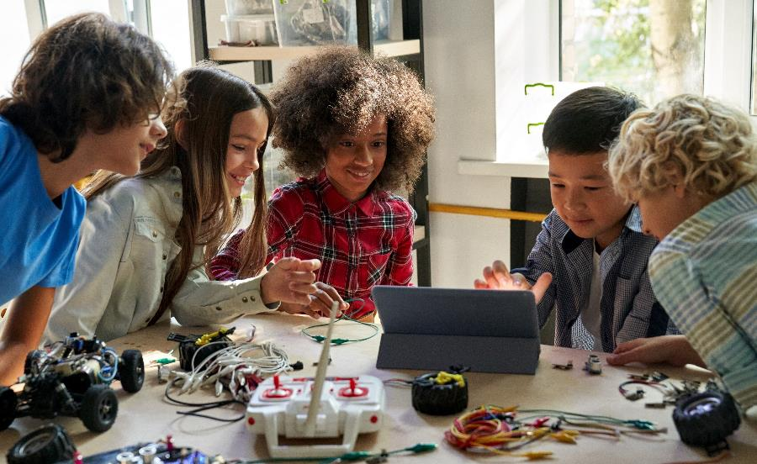
Perform Your Promotion
In your groups, plan and perform a television or radio advertisement for your product.
Think about how to appeal to your customers.
Notes:
Perform Your Promotion
Ask students to work in their business groups to plan and perform a television or radio advertisement for their product.
Remind them to speak clearly, not too fast, and at normal volume when they are presenting.
Assess spoken language during their performance.
Free Audacity software could be used to record their ads and do basic edits, including removing mistakes, adjusting volume, and adding music and/or sound effects. These could be played as part of the bake sale activity in the next stage.

Slide 9
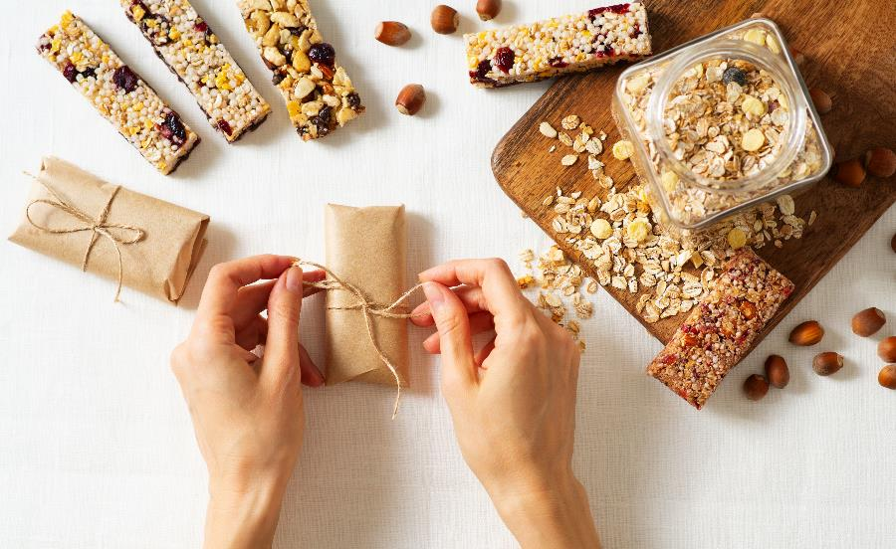
Packaging our Product
Most of food products in supermarkets come in packaging.
Some packaging can be recycled but a lot of it cannot.
Lots of our food is packaged in plastic that cannot be recycled and has to go into landfill.
Plastic packaging can a long time to decompose!
Notes:
Let’s Think About Packing our Product
Use the presentation to lead a discussion about the environmental effects of packaging, plastic, and paper.
In business groups, ask the children to brainstorm how they could package their product without plastic, using minimal paper.
Some examples of this to share could be beeswax wraps or reusable wheat flour bags.

Slide 10
Package Design
Design and make the packaging for your product.
Think about the recycled materials you will use.
Think about how to appeal to your customers.
How will you make your product stand out from the competitors on the shelf?
Notes:
Design Your Packaging
Ask students to draw and label a sketch of their packaging. Remind them to think carefully about how they can make their product stand out from its competitors on a shelf.
The students could then make and decorate an example of the packaging.
Alternatively, the Foldify iPad application could be used to design packaging nets. The children could select an appropriate template, add custom artwork and then print, cut out, and fold their nets to create packaging.

