Slide 1
Stage 8 - Making Granola Bars
© The National Farmers’ Union of England and Wales - All rights reserved. These resources may be reproduced for educational use only.

Slide 2
Learning Objectives
Produce granola bars to sell in a farm store.
Prepare ingredients safely.
Measure ingredients and read scales accurately.
Use fractions to halve the required ingredients.
Write instructions.
Notes:
Learning Objectives
Produce granola bars to sell in a farm store.
Prepare ingredients safely.
Measure ingredients and read scales accurately.
Use fractions to halve the required ingredients.
Write instructions.

Slide 3
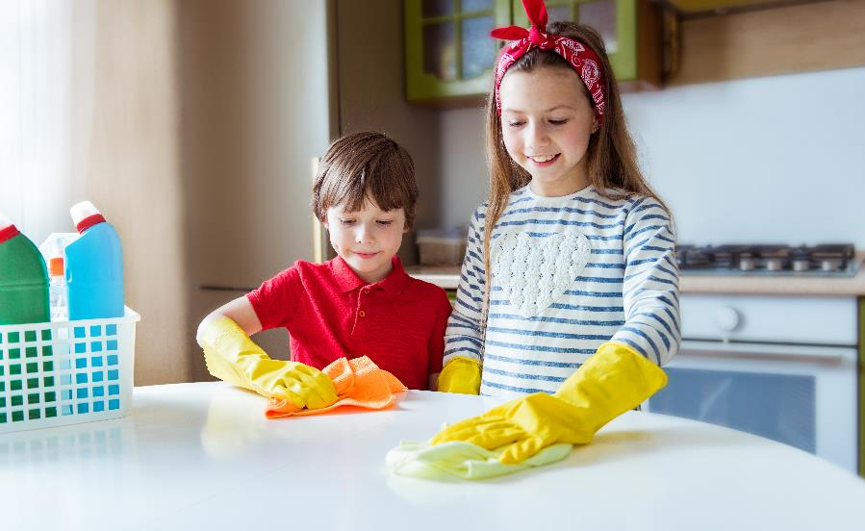
Get Ready to Cook!
Tie back long hair.
Roll up your sleeves.
Put on an apron.
Clean the work surfaces.
Wash your hands before you touch food.
Notes:
Get Ready to Cook!
Explain that before we can begin preparing our food products, we need to wash our hands thoroughly with soap and water, tie back long hair, roll up our sleeves, put on an apron, and clean our work surfaces.

Slide 4
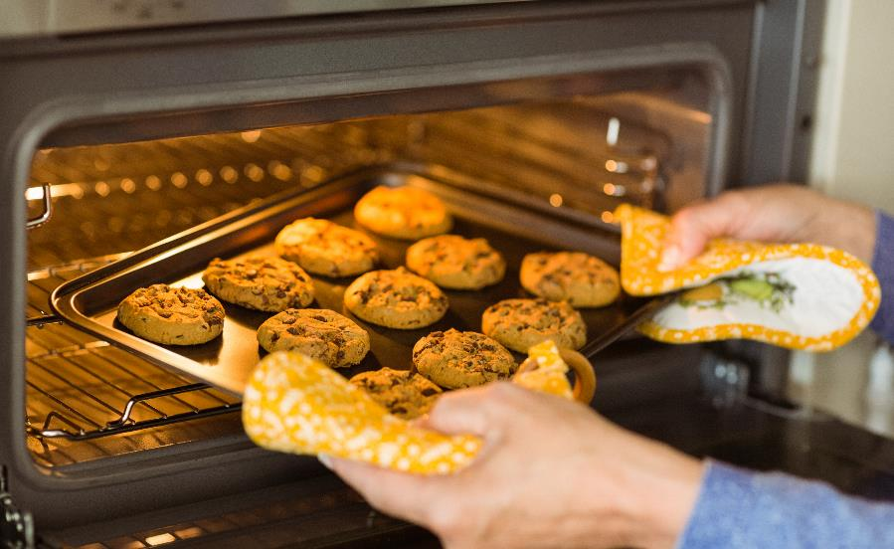
Kitchen Safety
Look around the room. What possible dangers do you see?
How can we stay safe in the kitchen?
Notes:
Safety in the Kitchen
Ask the students to look around the room and spot the potential hazards, e.g. sharp knives, peelers, graters, hot ovens, pans, liquids, or foods that have spilled.
Take feedback and make sure the student’s attention is drawn to the hazards before they begin preparing their products.

Slide 5
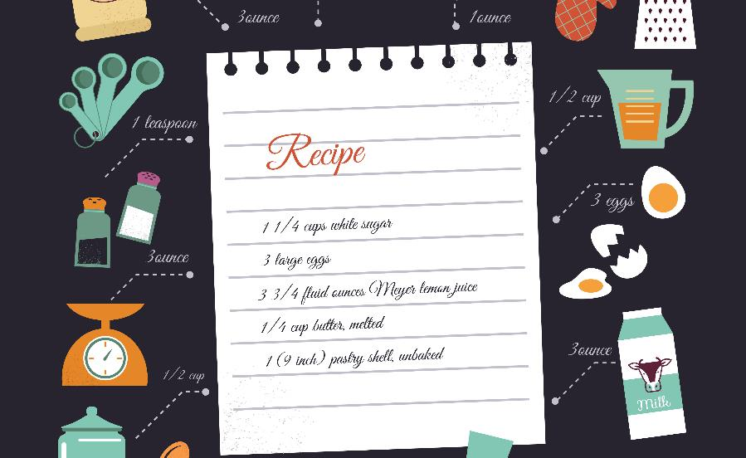
Tesing the Recipe
We are going to make only half the recipe so we can test it. If we do not like it, we can change the recipe.
Look at your recipe. How will you work out what you will need to make half the recipe?
Notes:
Testing the Recipe
Ask students what we need to do if we wanted to make half of the amount on the recipe so that we can test and adapt it before making a final batch.
Agree that all the ingredients need to be divided by two and model the method you would like the students to use and then allow time for them to complete this.

Slide 6
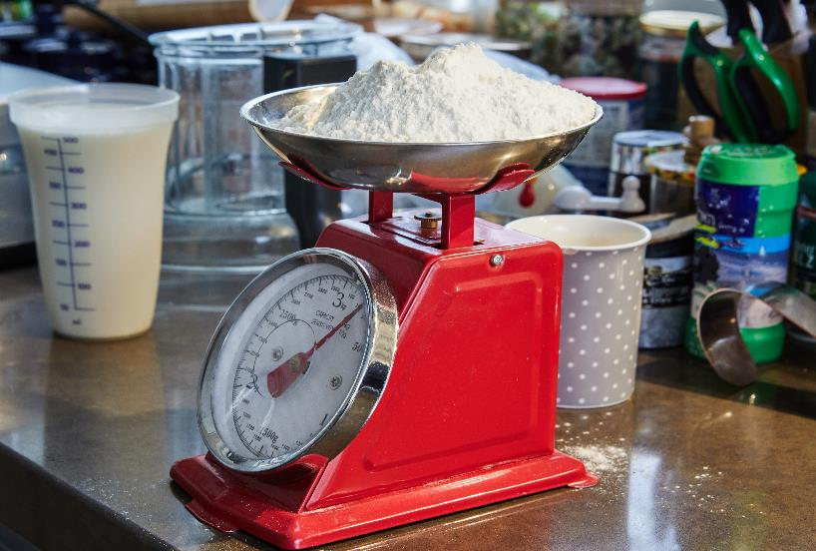
Measuring Accurately
Read the recipe carefully. Pay attention to teaspoon and tablespoon. They are not the same!
To measure dry ingredients, fill the measuring cup or spoon to the top. Make the ingredient level by scraping the top with a flat edge (a butter knife, the handle of a spoon).
Notes:
Measuring Accurately
Model how to measure liquid ingredients accurately using a measuring cup.
Model how to estimate the amount of dry ingredients needed and then measure them accurately using weighing scales.
Ask students to estimate the amount of dry ingredients they would need before measuring it accurately.
Remind students to take a photo of each stage of making their recipe.

Slide 7
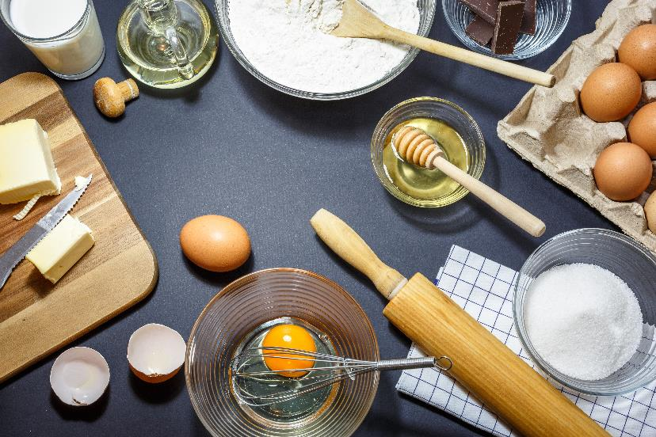
Measuring Accurately
To measure wet ingredients, place your measuring cup on an even surface.
Work with a partner and ask them to look at the measuring cup with their eyes level with the line that says how much you need.
Pour carefully and slowly until your partner tells you to stop
Notes:
Measuring Accurately
Model how to measure liquid ingredients accurately using a measuring cup.
Model how to estimate the amount of dry ingredients needed and then measure them accurately using weighing scales.
Ask students to estimate the amount of dry ingredients they would need before measuring it accurately.
Remind students to take a photo of each stage of making their recipe.

Slide 8
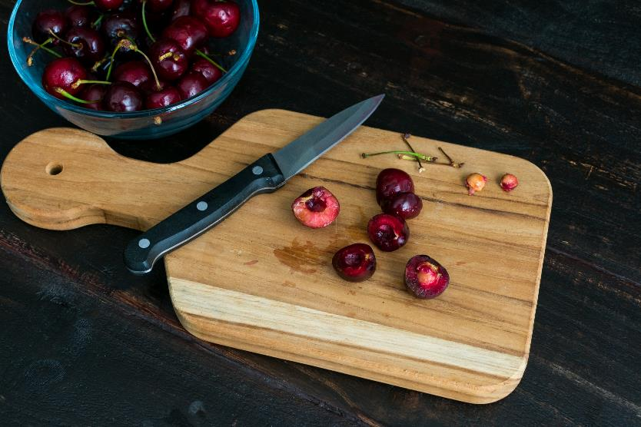
Knife Safety
You may need to cut ingredients, you will use a knife to cut your granola into bars.
Keep knife blade facing away from you. If it has a cover, hold the knife by its handle, pinch the cover’s tip, and pull gently.
Do not swing arms. It is dangerous!
Your knife is now “active.” Keep it in the safety zone (your chopping board). You will put yourself and others in danger if it moves away.
Notes:
Knife Safety
Before students make their granola bars, use the presentation to model how to safely prepare the ingredients. These slides could also be printed and laminated so that students can refer to them while they work.
Instruct your class to start making their recipe. Remind them to take pictures of each of the steps to help them later on in this project when they write down or visualize their recipe.

Slide 9
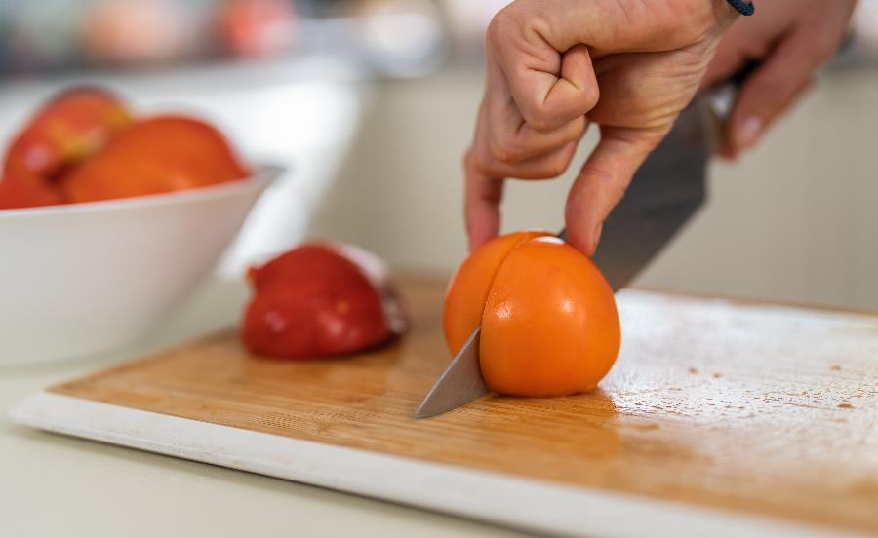
Cutting Food:
Bridge Method
Hold knife firmly with blade down.
Hold the food with other hand. Keep hand open with fingers together.
Put fingers and thumb on either side of food. Hold firmly.
Put knife through the middle of “bridge” to cut the food.
Watch what you are doing. Be careful that fingers are not where they can be cut.
Notes:
Bridge Method
Before students make their granola bars, use the presentation to model how to safely prepare the ingredients. These slides could also be printed and laminated so that students can refer to them while they work.
Instruct your class to start making their recipe. Remind them to take pictures of each of the steps to help them later on in this project when they write down or visualize their recipe.

Slide 10
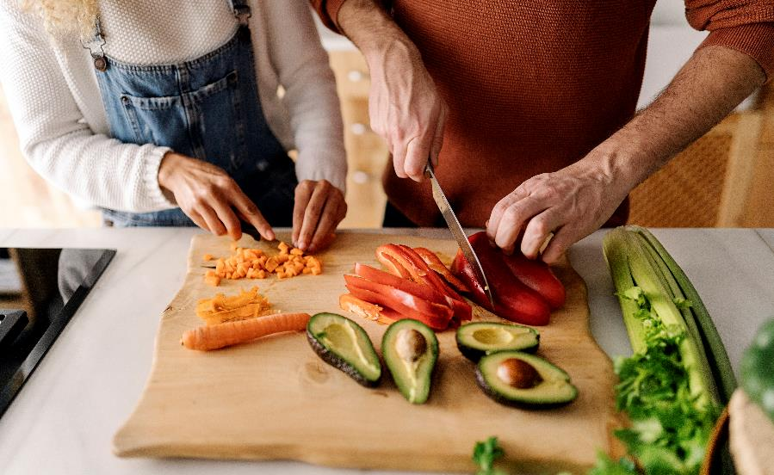
Cutting Food:
Claw Method
Hold knife firmly with blade down.
Your other hand will hold the food. Make a claw with fingers curved a little and your thumb behind.
Keep fingertips close together. Hold food firmly with the tips of fingers.
Slice in front of your fingertips.
Watch what you are doing. Be careful that your fingers are not where they can be cut.
Notes:
Claw Method
Before students make their granola bars, use the presentation to model how to safely prepare the ingredients. These slides could also be printed and laminated so that students can refer to them while they work.
Instruct your class to start making their recipe. Remind them to take pictures of each of the steps to help them later on in this project when they write down or visualize their recipe.

Slide 11
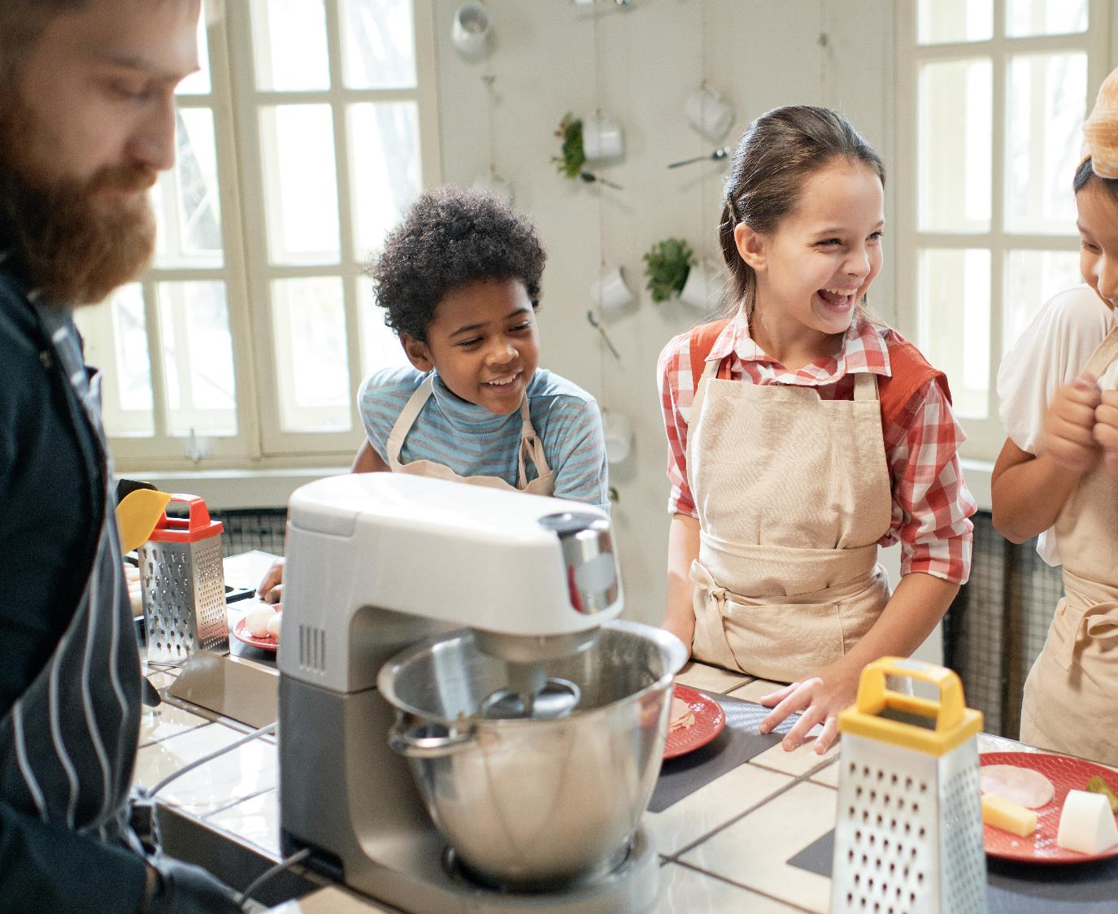
Time to Make Recipes
Notes:
Time to Make our Recipes

Slide 12
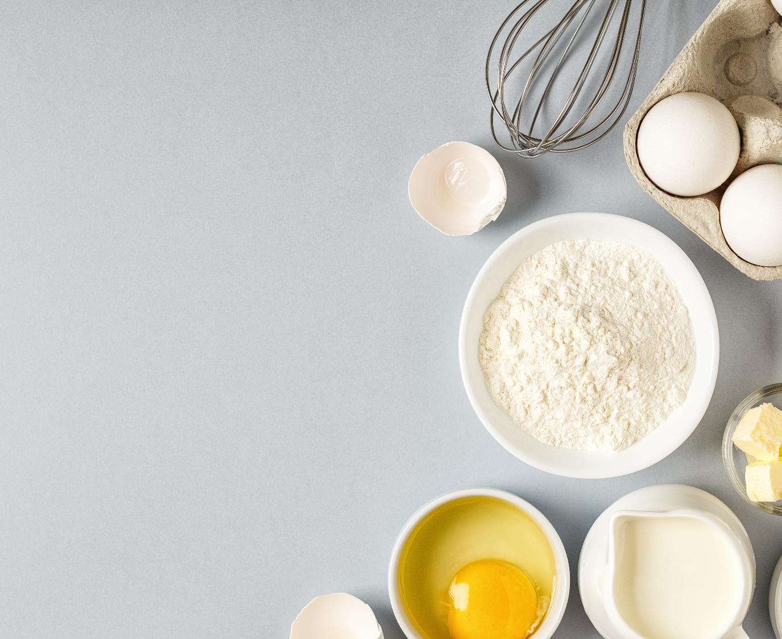
Evaluation
What could you do next time to improve your product? As a class, decide on a rubric and scoring system.
Feature | Score | Comment (give reasons for your score)
Presentation
Texture
Taste
Value for Money
Notes:
Evaluation
Once the students have made their product using the recipe, give them the opportunity to evaluate their work using the question prompts on the presentation.
If they have any changes they would like to make to their recipe, encourage them to write them down after they have tasted and evaluated it.
Give the students the opportunity to make a full batch of their newly improved granola bar recipe to be sold.

Slide 13
Writing Your Recipes
You may wish to include some or all of these in your recipes:
Title – the name of your granola bar.
Subheading – a second, smaller title.
Ingredients/equipment list – the food and tools you need for this recipe.
Numbered steps – be sure to get the steps in the right order!
The right words – use cups, tablespoons, teaspoons so people making your recipe will get the measurements right.
Labelled diagrams – if you use pictures, let people know what is happening in the picture.
Notes:
Writing Your Recipes
Recap the features of a set of instructions and display them using the presentation.
Ask the students to write a detailed set of instructions for their new recipe in child-friendly language.
The students could then use the ‘Comicbook!’ iPad application to make a visual guide to making granola bars. They could include their photographs of each stage of the making and add captions, speech bubbles, thought bubbles, stickers, and filters to enhance their work.
As an extension, they could also use a green screen iPad application such as ‘DoInk’ to create a cooking show. The students could star as TV chefs creating granola bars, and talking about what they have learned along the way, e.g. kitchen safety, where the ingredients have come from etc.

