Slide 1
Stage 7 - Designing a Healthy Recipe and Conducting Market Research
© The National Farmers’ Union of England and Wales - All rights reserved. These resources may be reproduced for educational use only.

Slide 2
Learning Objectives
Learn how grains are important and healthy. Develop a recipe for a healthy snack bar.
Design two granola bar flavours for the target market.
Understand why you should use local ingredients.
Design a survey.
Make a pictograph or bar graph to show market research results.
Use data for decision-making.
Notes:
Learning Objectives
• Learn how grains are important and healthy. Develop a recipe for a healthy snack bar.
• Design two granola bar flavours for the target market.
• Understand why you should use local ingredients.
• Design a survey.
• Make a pictograph or bar graph to show market research results.
• Use data for decision-making.

Slide 3
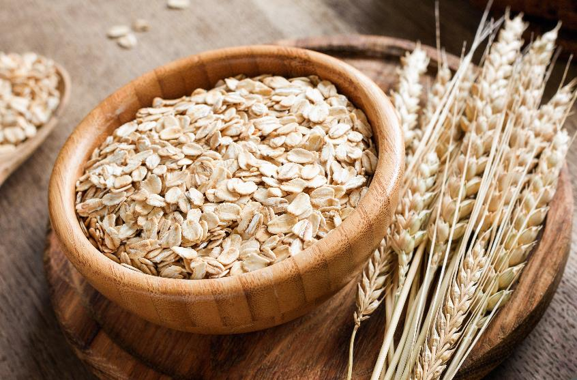
Grains in our Diet
Grains are important to a healthy diet.
Grains give your body carbohydrates, protein, fat, and several minerals for good health.
The grain products we love have refined or whole grains. Refined means they have been more processed than whole grains. Both are healthy choices. Choose what you prefer.
Notes:
Grains in our Diet
Explain: grains are an important part of a healthy diet. Ontario produces several types of grains: barley, corn, oats, soybeans, and wheat. They provide your body with carbohydrates, protein, fat, and several minerals important for good health.
The grain products we love contain refined or whole grains. Refined means they have had more processing than whole grains. Both are healthy choices and which one you eat is a matter of preference.
People who cannot eat gluten can find gluten-free grain products such as Ontario-grown corn, soybeans, and oats. Display images of products made with different grains and have students identify which grain is an ingredient.

Slide 4
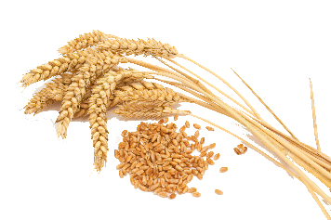
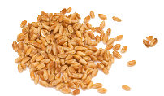
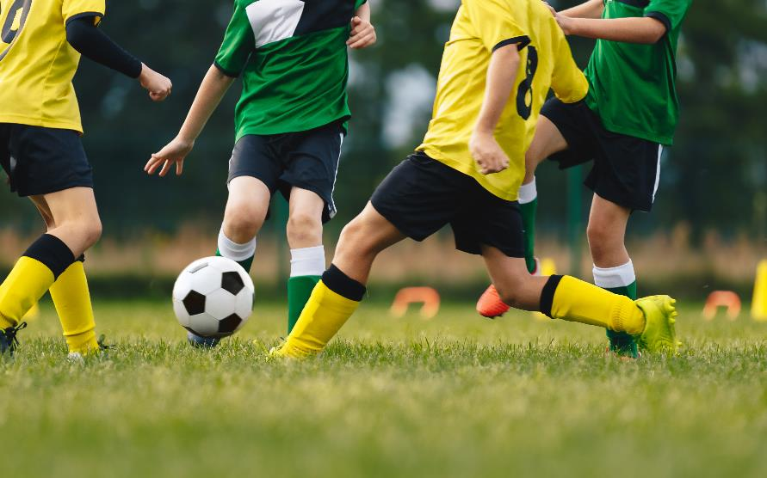
Energy
What we eat affects how much energy we have. We need energy for exercising, playing, and concentrating in school.
As we move and work, we burn the energy we get from our food.
Some foods are better than others for giving us a slow release of energy throughout the day.
Grains are an excellent source of slow-release energy.
Notes:
Energy
Explain: in this stage, students will design their new granola bar products.
Remind students of the importance of a balanced diet and use the presentation to discuss the health benefits of grains.

Slide 5
Design Your Product
You are going to design a new granola bar.
Look at the basic recipe. Decide your two grain ingredients.
Brainstorm ideas for other tasty flavours such as:
Lemon zest or honey and raisins.
Cranberries and orange zest.
Look at recipe books or the Internet for flavours that go together.
Pick three flavours for your bar for your market research.
Notes:
Design Your Product
In business groups, ask students to decide as a group which two grain ingredients they want to include in their basic granola bar recipes.
• Provide groups with the basic granola bar recipe to adapt and ask students to brainstorm ideas for ingredients they could add to their bars for additional flavours.
Provides ideas to help students get started (e.g., lemon zest or honey with raisins or cranberries with orange zest).
Students may wish to use recipe books or the Internet to research which flavours work together, take inspiration from their taste-testing in stage 2, or they could invent a new flavour combination.
Ask students to be mindful of allergies, especially to nuts, in the school as they explore ingredients. Remind them that soybeans can be made into soy butter if they need a creamy ingredient.
Ask groups to research the nutritional benefits of their ingredients and to find out where they are grown so they can consider their food miles.

Slide 6
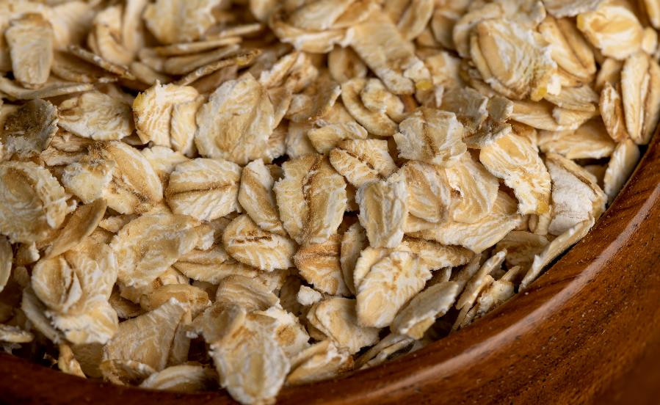
Your Ingredients
As you think about ingredients, research how healthy they are.
Where do the ingredients come from? What are their food miles?
Are there children with allergies in your school? Do you need to avoid certain ingredients, like nuts?
Notes:
Your Ingredients
Ask business groups to think of three flavour ideas for their bars.

Slide 7
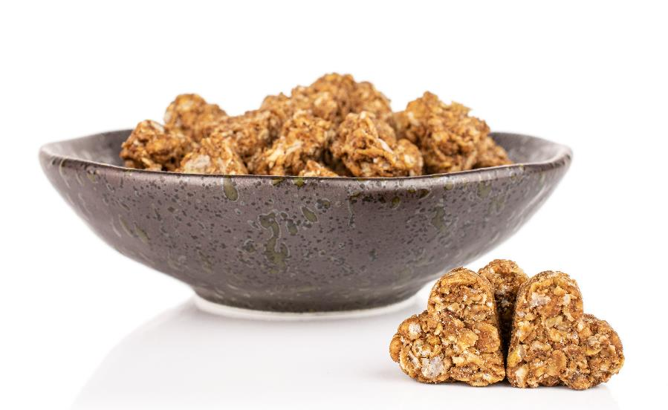
Unique Selling Point
How will you make your granola bar stand out? This is your unique selling point.
What can you give customers that is different from the competition?
Will your bar be a different shape?
Will you use a high fibre recipe?
Will your bar be made with locally grown ingredients?
Notes:
Unique Selling Point
Introduce the idea of a “Unique Selling Point” (USP) or something they can offer consumers that is different from the competition. Have them consider a customer need they can meet that is not being met.
Ask students to consider what their USP will be. Will it be a different shape bar? Will they use a high-fibre recipe? Will their bar be made entirely with locally grown ingredients?
Give the children guidance as they make their choices to ensure their ideas will be achievable with the resources and time available.

Slide 8
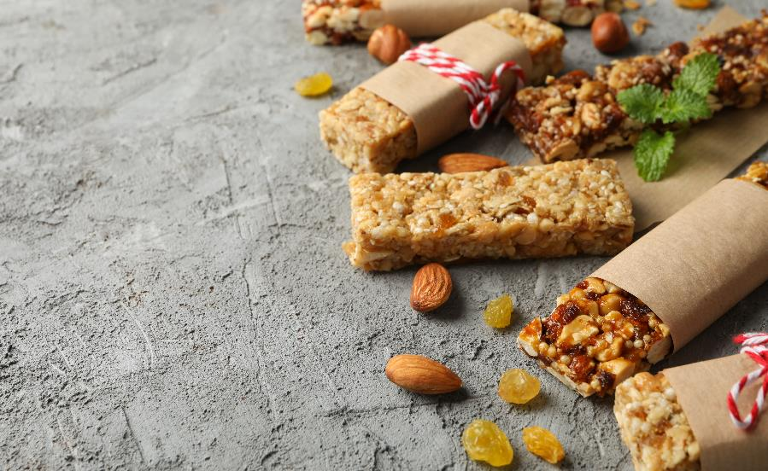
?
Market Research
Write your research question. Example: Which flavour of granola bar is the most popular with students in our class?
Ask as many students as possible and record your results in a tally table.
Notes:
Market Research
Using the PowerPoint presentation, raise questions to introduce market research and how students can use it to help them decide which flavour granola bar they should make.
Explain: students are going to conduct a survey and record their results using a tally table. We do this by asking many people which of our flavour ideas they prefer. We can focus on people we think will buy our product.
By asking customers what they would prefer, students can make a product customers are more likely to buy and be happy with.
To display their results, they will learn about pictographs on slide 11.

Slide 9
Tally Tables
Draw a table with two columns. One is for your granola bar flavour ideas. The other is for how many people voted for them.
Each time someone votes for a flavour, make a tally mark. For the fifth tally mark, draw a line through your first four tally marks.
Granola bar flavour | Tally
Lemon and Raisin | I
Cranberry and Orange | II
Honey and Raisin | IIII
Notes:
Tally Tables
Explain: for this survey, we need to ask a closed multiple choice question. We will offer a small range of granola bar flavour options and ask participants to choose the option they would like most. This will tell us whether people will want to buy our product.
• Once they have decided on their flavours, ask the business groups to write down their research question(s) (e.g., what is the most popular granola bar flavour in Grade 3 in our school?).
• Students may like to extend their survey by asking a second question about the factors that would affect their buying behaviour (e.g., price, fair trade, local produce, allergy).
Before they collect their data, ask students to draw a tally table to record their findings (or use the tally table template found at the end of the lesson plan).
Use the example in the slide to model how to record results in a tally table.
Give students the opportunity to collect answers from as many children as possible (consider using students from a range of grades).
Allow time for group members to give feedback on their findings and draw conclusions about the most popular flavour among their target customers.

Slide 10
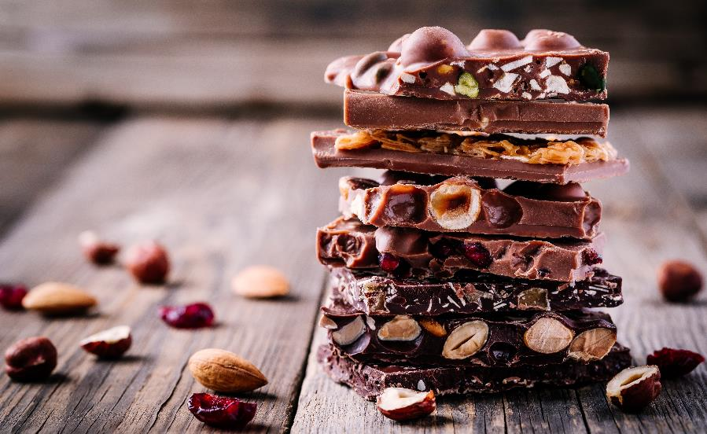
Chocolate Bar
CHALLENGE!
Fill one square on your chocolate bar with one fact you know about pictographs.
Trade facts with your friends. Each of you can add your new facts to your chocolate bars.
Keep swapping facts in the class until your chocolate bar is full of pictograph facts!
Notes:
Chocolate Bar CHALLENGE!
Ask students to write a list of top tips for drawing pictographs. This could be completed as a chocolate bar challenge activity: each child has a plain piece of paper they fold into six segments. They fill one segment with their own idea and then collect answers from their peers to fill the remaining segments and they have six different top tips for drawing pictographs.

Slide 11
Drawing a Pictograph
Draw a table with two columns, one for your granola bar flavours, the other for how many people voted for them.
Draw one symbol for every two people who voted for each flavour.
Add a key.
How can we show an odd number of votes?
How many people voted for each flavour?
Granola bar flavour | Number of Votes
Lemon and Raisin
Cranberry and Orange
Honey and Raisin
Key
=2
Notes:
Drawing a Pictograph
Use the example in the slide to take students through each stage of drawing a pictograph and share tips for drawing one.
Model each step of constructing a pictograph.
Ask students to construct a pictograph to display their market research results. You could extend them here by also covering how to draw an additional bar graph.

Slide 12
Your Final Decision
Discuss your results with your business group. Make a final decision about your granola bar.
It is time to write your shopping list!
Notes:
Your Final Decision
Ask groups to reach a final decision about the flavour of their granola bar and write two sentences to explain what their market research showed and their group’s final decision.
At the end of the lesson, students should write a shopping list for the ingredients they wish to add to their granola bars and give it to their teacher.

