Slide 1
Stage 6 – Designing an Innovative Farming Machine
© The National Farmers’ Union of England and Wales - All rights reserved. These resources may be reproduced for educational use only.

Slide 2
Learning Objectives
Practice the engineering design process.
Follow the process by which foods are planted, grown, harvested and processed in order to become ingredients we use in cooking/baking.
Learn about modern farming equipment.
Discuss/review previous learning of the impact of environment on agriculture (and vice versa).
Notes:
Learning Objectives
Practice the engineering design process.
Follow the process by which foods are planted, grown, harvested and processed in order to become ingredients we use in cooking/baking.
Learn about modern farming equipment.
Discuss/review previous learning of the impact of environment on agriculture (and vice versa).

Slide 3
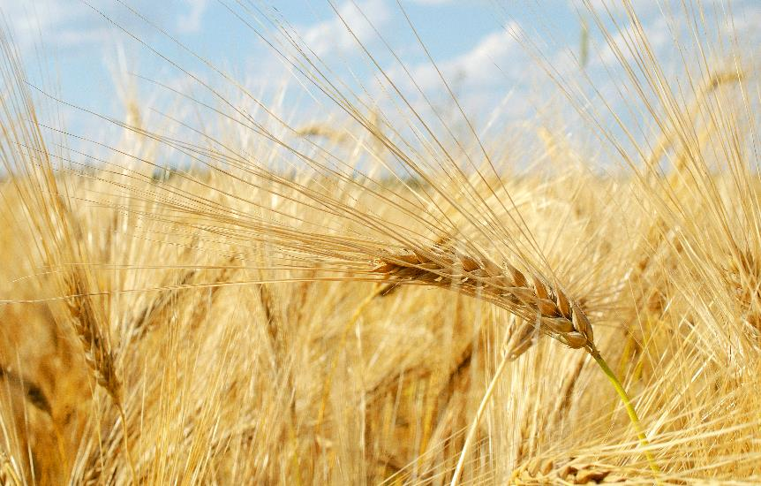
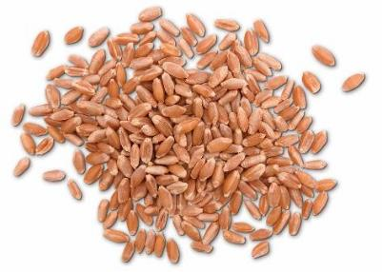
Grains
Many food products are made from grain plants like the ones we are growing.
These plants go through different processes so we can eat them.
Notes:
Grains
Explain: Many food products are made from grain plants like the ones we are growing but they have to go through different processes to become food.
Give the children the grain matching cards. Have them work in pairs to determine which food products are made from each grain.
Allow time for students to give their answers and share the video(s) to demonstrate the process involved in growing oats and wheat.
See how oats get from farm to fork, ready for your warm, tasty bowl of oatmeal:
The lives and work of Ontario grain farmers https://goodineverygrain.ca/2022/01/10/virtual-360-degrees-grain-farm-tour/
Good in Every Grain, a video about growing oats in Ontario
https://www.youtube.com/watch?v=lVdVmGS5zfs
From Saskatchewan, four videos about planting, harvesting, processing oats https://www.farmfood360.ca/en/oats/
How Bread is Made, animated video, wheat from seed to loaf
https://www.youtube.com/watch?v=glWpjy2qpPk

Slide 4
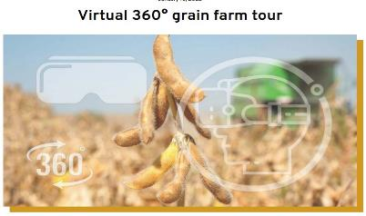
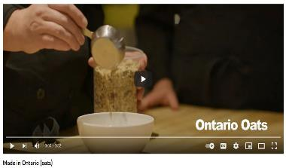
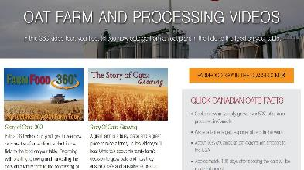
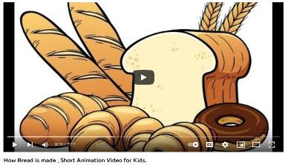
Grain Game!
Use the matching cards to work out which food products are made from each grain.
Notes:
Grain Game!
Explain: Many food products are made from grain plants like the ones we are growing but they have to go through different processes to become food.
Give the children the grain matching cards. Have them work in pairs to determine which food products are made from each grain.
Allow time for students to give their answers and share the video(s) to demonstrate the process involved in growing oats and wheat.
See how oats get from farm to fork, ready for your warm, tasty bowl of oatmeal:
The lives and work of Ontario grain farmers https://goodineverygrain.ca/2022/01/10/virtual-360-degrees-grain-farm-tour/
Good in Every Grain, a video about growing oats in Ontario
https://www.youtube.com/watch?v=lVdVmGS5zfs
From Saskatchewan, four videos about planting, harvesting, processing oats https://www.farmfood360.ca/en/oats/
How Bread is Made, animated video, wheat from seed to loaf
https://www.youtube.com/watch?v=glWpjy2qpPk

Slide 5
Engineering Design Process
Notes:
The Engineering Design Process
Use the PowerPoint presentation to share the stages of the engineering design process and then work through the stages.

Slide 6
?
Farm Machinery - Ask
Do you remember some of the challenges farmers face when growing crops?
?
?
Notes:
Farm Machinery - Ask
Explain: we will use the engineering design process to design our own planting machine. Our goal is to overcome challenges faced by farmers.
Ask students to remember some of the challenges farmers face that we learned about in previous stages (e.g., soil compaction, keeping nutrients in the soil, erosion).

Slide 7
Research
There are many types of machines used for harvesting and processing grains. Each group will be allocated a piece of farming machinery to research.
Areas of research:
What does it do?
How does it work?
What are the advantages of using this machine?
What are the disadvantages of using this machine?
Make notes on your activity sheet.
Notes:
Research
Watch the video to explain how a seed drill works: How Do You Plant Ontario Grains? https://www.youtube.com/watch?v=0ML0x7Cehn8
Allocate one piece of farming machinery to each business group and ask them to research what it does, how it works, and some of its advantages and disadvantages. For example, you could use a cultivator, a seed drill, a crop sprayer, and a combine harvester.
Ask students to make their notes on the Farm Machines Note Making Template and then present their findings to the class.

Slide 8
Seed Drill
A farmer uses a seed drill to plant seeds. A tractor pulls the seed drill.
Some seed drills scrape a small furrow in the soil, plants the seed in the furrow, and covers them with soil.
An air drill is a type of seed drill that uses air to push the seeds into the ground without digging up the soil.
All types of seed drills plant seeds at the best depth and with the best spacing for plants to grow.
This video shows an air drill
Notes:
Seed Drill
Watch the video to explain how a seed drill works: How Do You Plant Ontario Grains? https://www.youtube.com/watch?v=0ML0x7Cehn8
Allocate one piece of farming machinery to each business group and ask them to research what it does, how it works, and some of its advantages and disadvantages. For example, you could use a cultivator, a seed drill, a crop sprayer, and a combine harvester.
Ask students to make their notes on the Farm Machines Note Making Template and then present their findings to the class.

Slide 9
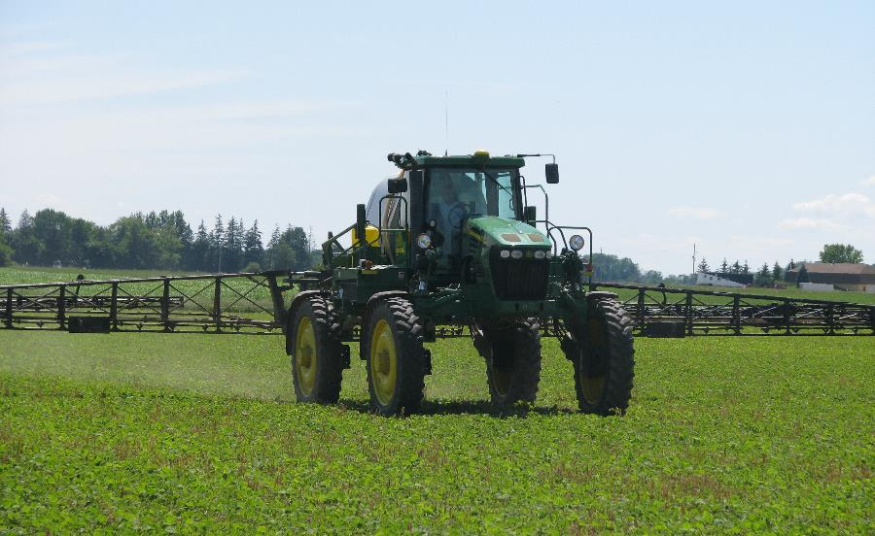
Crop Sprayer
Some crops are sprayed with insecticides to kill pests such as insects, worms, or harmful bugs.
Some crops are sprayed with fungicides to prevent them from growing a disease.
Some crops are sprayed with herbicides to kill weeds.
Many people do not know that crop spraying is also used in organic farming.
Notes:
Tractor Driven Crop Sprayer
Watch the video to explain how a seed drill works: How Do You Plant Ontario Grains? https://www.youtube.com/watch?v=0ML0x7Cehn8
Allocate one piece of farming machinery to each business group and ask them to research what it does, how it works, and some of its advantages and disadvantages. For example, you could use a cultivator, a seed drill, a crop sprayer, and a combine harvester.
Ask students to make their notes on the Farm Machines Note Making Template and then present their findings to the class.

Slide 10
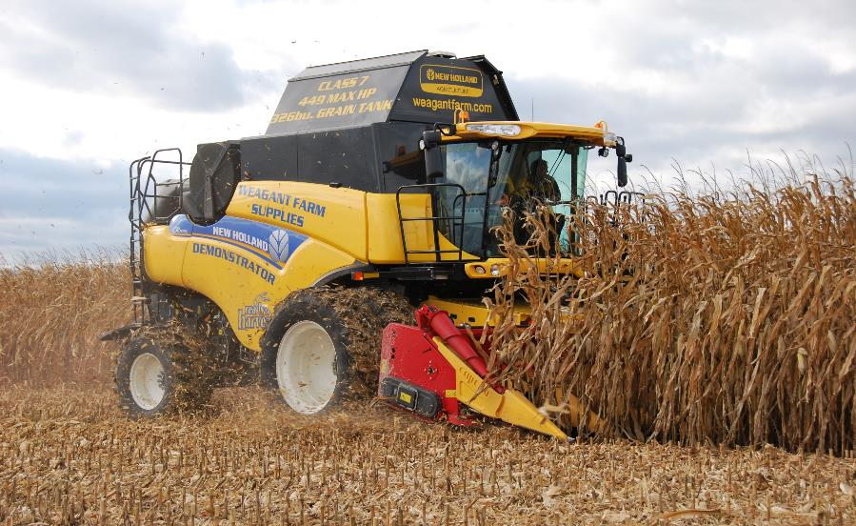
Combine Harvester
A combine harvester cuts the grain plants like corn or wheat and separates the grain from the stalks (straw).
The grain seeds are stored in the combine before being moved to a tractor trailer. The straw comes out the back of the machine.
Notes:
Combine Harvester
Watch the video to explain how a seed drill works: How Do You Plant Ontario Grains? https://www.youtube.com/watch?v=0ML0x7Cehn8
Allocate one piece of farming machinery to each business group and ask them to research what it does, how it works, and some of its advantages and disadvantages. For example, you could use a cultivator, a seed drill, a crop sprayer, and a combine harvester.
Ask students to make their notes on the Farm Machines Note Making Template and then present their findings to the class.

Slide 11
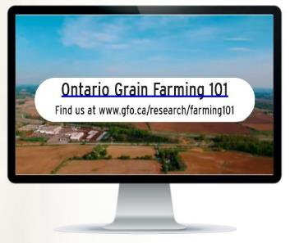
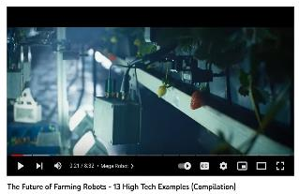
Imagine
We will learn about some innovative farming technology. Farmers use modern technology to make modern farming more efficient, environmentally friendly, and help produce more food.
See how robots work on farms by using GPS technology, artificial intelligence for mapping, and even how we could farm in space!
Notes:
Imagine
Explore the role of technology on farms.
This video, The Future of Farming Robots, shows how farming technology can use AI mapping, GPS, and robots within the natural environment. Robots can help make farming more efficient, environmentally friendly, and productive. https://www.youtube.com/watch?v=uD4mJCgsmdM

Slide 12
Plan
Once you have completed your research, begin planning your planting machine design.
Think about how your planting machine will work and label your sketch to add detail.
Think about how you can adapt and improve the machine using what you have learned.
Even if you are designing a different type of machine, think about the seed planter design you saw in the video. How could students modify the seed planter to plant a larger area of the field at a time, so the farmer could plant a field of grains faster.
Notes:
Plan
Ask students to start planning their planting machine designs using a labelled sketch.
To simplify this activity, you could use this example as a starting point: https://www.curiositymachine.org/challenges/121/
If you opt to use the tutorial in the video, which shows a plan for a seed planter that drops one seed at a time, the activity could be to think about how to adapt and improve the tutorial’s planter using what they have learned. For example, real seed drills plant hundreds of seeds at a time. How could students modify the seed planter to plant a larger area of the field at a time, so the farmer could plant a field of grains faster.

Slide 13
Create
Working in your group, build your planting machine out of recycled materials.
Think about which materials you will use for each part of the machine.
Notes:
Create
Working in groups, ask students to build their farming machine using recycled materials. This could be a homework task if you are short of time.

Slide 14
Test and Improve
Test your machine!
Use the evaluation sheet to make notes on:
What went well with your design?
What would you like to improve?
Use these notes to make adjustments to your machine to make it work even better.
Notes:
Test and Improve
Give the students an opportunity to test their new machine and make adjustments to it.
Using the evaluation template, ask students to evaluate what has gone well with their machine design and what they would like to improve.

Slide 15
Present
As a group, present your design to the rest of the class.
In your presentation you will need to include:
How your machine works
The farming challenge you are solving with your machine.
Notes:
Present
Ask groups to present their designs to the class and explain the farming challenge they are solving.

