Slide 1
Stage 5 – Soil in the Environment
© The National Farmers’ Union of England and Wales - All rights reserved. These resources may be reproduced for educational use only.

Slide 2
Learning Objectives
Understand the importance of soil and soil health.
Understand soil composition.
Assess human impact on soils, ways we can improve the quality of soils, and how farmers protect and maintain soil health.
Notes:
Learning Objectives
Understand the importance of soil and soil health.
Understand soil composition.
Assess human impact on soils, ways we can improve the quality of soils, and how farmers protect and maintain soil health.

Slide 3
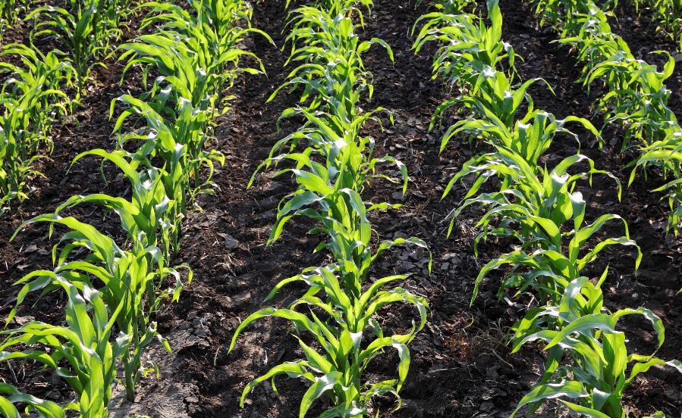
Recap
We learned plants need the right amount of water and light to make food in their leaves in a process called photosynthesis.
Plants also need nutrients from the soil.
Notes:
Let’s Recap What we Have Learned in the Last Session
Revisit the conditions plants need to grow and be healthy from stage 3.
Take students outside to collect their own soil samples from various locations on the school property (works well in dixie cups). Or, hand out pre-collected samples.
Let students examine soil samples and discuss similarities and differences. Use the Types of Soil in Ontario sheet to identify their soil samples.
Based on this exploration, ask students to discuss what they think soil is. What types of soil make up your school grounds? Take feedback.
Watch the video to learn about soil: https://www.youtube.com/watch?v=if29mjcd5bc
Soil is made up of minerals from broken-down rocks, air containing gases such as carbon dioxide and oxygen, water, and organic matter from decaying plants and animals.
The well-being of all plants and land-based animals depends on the complex processes that take place in soil. To grow healthy crops, you need healthy soil. What do we mean by that?
Healthy soil has high soil biodiversity, which means the number of living things or organisms in it, such as earthworms, insects, microbes, and plant roots. They all contribute toward the ecosystem in the soil. Did you know soil is home to a quarter of our planet’s biodiversity? It is one of nature’s most complex ecosystems and one of the most diverse habitats on earth; just one teaspoon of healthy soil can contain more living organisms than there are people living on earth!

Slide 4
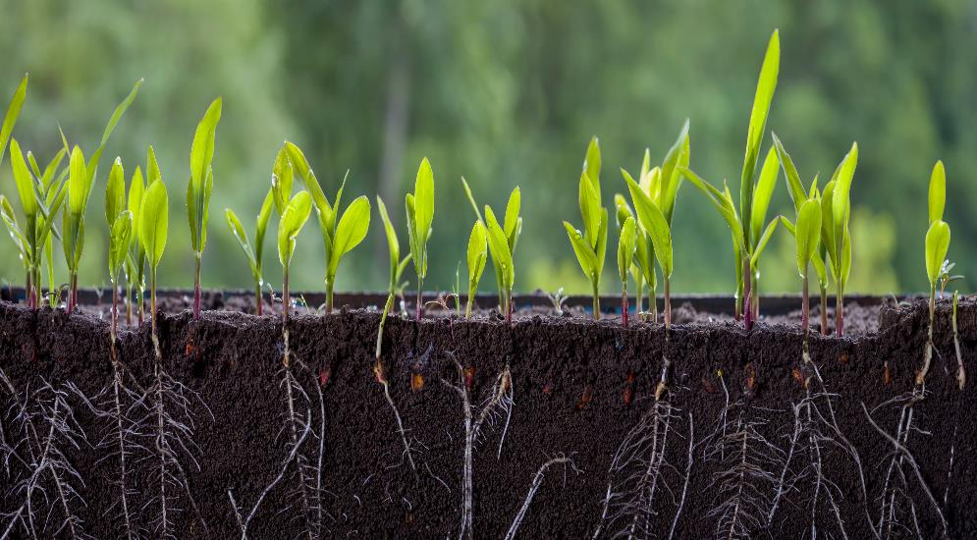
Types of Soil
In your groups, you are going to look at a selection of soil samples.
What are their similarities?
What are their differences?
What do you think soil is?
Notes:
Types of Soil
Take students outside to collect their own soil samples from various locations on the school property (works well in dixie cups). Or, hand out pre-collected samples.
Let students examine soil samples and discuss similarities and differences. Use the Types of Soil in Ontario sheet to identify their soil samples.
Based on this exploration, ask students to discuss what they think soil is. What types of soil make up your school grounds? Take feedback.

Slide 5
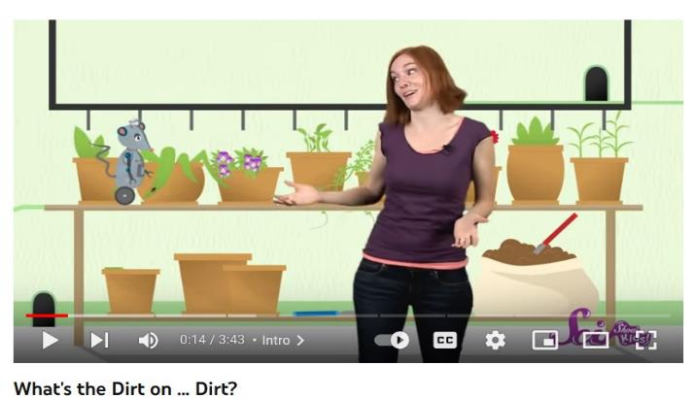
What is Soil?
Watch the video to learn what soil is made up of:
https://www.youtube.com/watch?v=if29mjcd5bc
Notes:
What is Soil?
Watch the video to learn about soil: https://www.youtube.com/watch?v=if29mjcd5bc

Slide 6
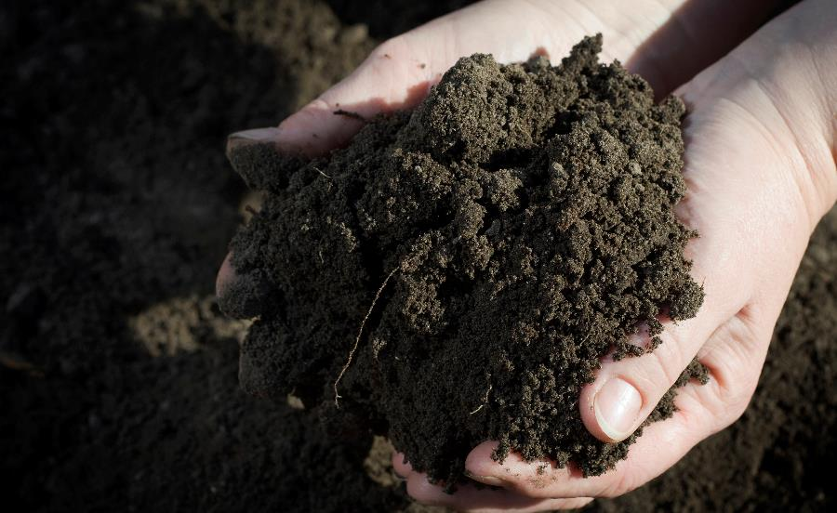
?
What is Soil?
Soil is made up of minerals from broken-down rocks, air containing gases such as carbon dioxide, oxygen, water, and organic matter from decaying plants and animals.
The well-being of all plants and land-based animals depends on the complex processes that take place in soil. To grow healthy crops, you need healthy soil.
Notes:
What is Soil?
Soil is made up of minerals from broken-down rocks, air containing gases such as carbon dioxide and oxygen, water, and organic matter from decaying plants and animals.
The well-being of all plants and land-based animals depends on the complex processes that take place in soil. To grow healthy crops, you need healthy soil. What do we mean by that?

Slide 7
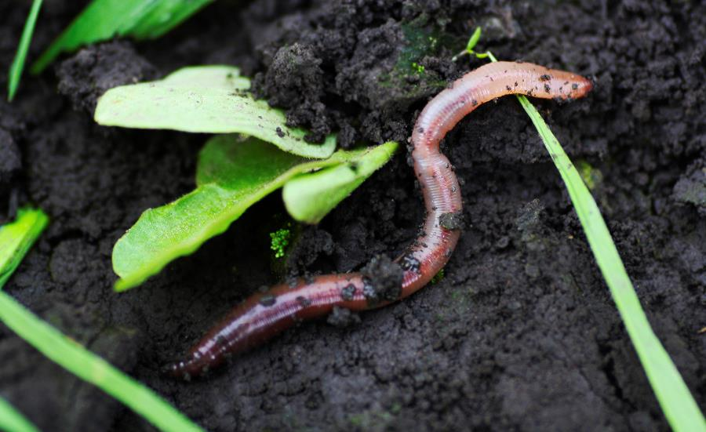
Healthy Soil
Healthy soil has biodiversity, a variety of living things or organisms such as earthworms, insects, microbes, and plant roots.
Soil is one of nature’s most complex ecosystems and one of the most diverse habitats on earth.
Did you know just one teaspoon of healthy soil can contain more living organisms than there are people living on earth?
Notes:
Healthy Soil
Healthy soil has high soil biodiversity, which means the number of living things or organisms in it, such as earthworms, insects, microbes, and plant roots. They all contribute toward the ecosystem in the soil. Did you know soil is home to a quarter of our planet’s biodiversity? It is one of nature’s most complex ecosystems and one of the most diverse habitats on earth; just one teaspoon of healthy soil can contain more living organisms than there are people living on earth!
Did you know soil is home to a quarter of our planet’s biodiversity? It is one of nature’s most complex ecosystems and one of the most diverse habitats on earth; just one teaspoon of healthy soil can contain more living organisms than there are people living on earth!

Slide 8
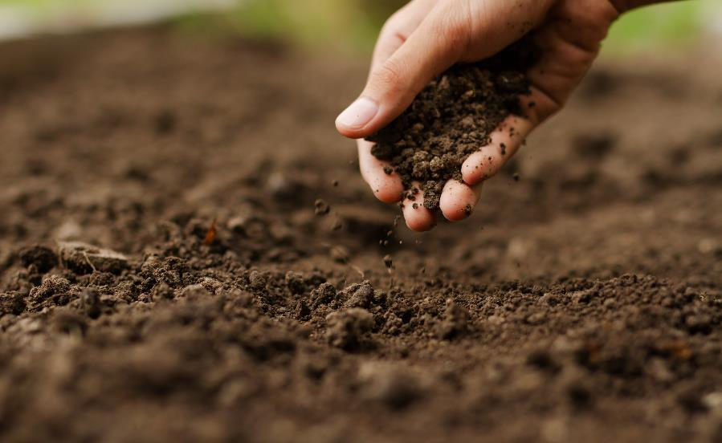
Soil and Farming
Farmers work hard to ensure their soils stay healthy and full of nutrients for their plants.
However, they face some challenges when looking after their soil.
Notes:
Soil and Farming
Farmers work hard to ensure their soils stay healthy and full of nutrients for their plants.
However, they face some challenges when looking after their soil.

Slide 9
What is Compacted Soil?
Soil is compacted when something presses down on it, pushing the tiny soil particles together.
When soil is compacted, it is more difficult for water to drain through the soil. Roots have trouble growing through the soil. Seedlings (new plants) cannot get through soil to reach for the sun.
It can increase the risk of flooding, water erosion, and soil movement.
Notes:
What is Compacted Soil?
Soil is compacted when something presses down on it and soil particles are pushed together, which can make it more difficult for water to drain through the soil, roots to grow through the soil, and even seedlings to emerge from the soil. It can increase the risk of flooding, water erosion, and unnecessary soil movement.

Slide 10
What Causes it?
Heavy rainfall can be harmful to soil. Each drop is like a tiny hammer, making a hole in the soil.
Driving on soil, especially with heavy vehicles, can leave deep marks. Even walking on soil a lot can compact it. You may have seen a path worn in a field or yard; that is compacted soil.
Growing the same crop year after year can hurt the soil. Plant roots help hold the soil together while they absorb water and nutrients.
Notes:
Compacted Soil – What Causes it?
Soil can be compacted by heavy rainfall, driving on it a lot, or even a lack of crop diversity on farms. Different types of soil can be affected differently in the same conditions.

Slide 11
How are Farmers Helping?
Farmers are changing how they farm to reduce soil compaction.
Planting cover crops helps to protect soil in winter.
Farmers are finding ways to drive less on their fields. All together in Ontario, farmers save more than 170 million litres of fuel per year. That is like taking 122,000 cars off the road!
Farming today uses a lot of technology, equipment that flies (really!) and inventing equipment that does not have big tires.
Notes:
Compacted Soil – How are Farmers Helping?
Farmers are changing how they farm to reduce soil compaction. Farmers are planting cover crops to protect soil in winter and driving less on their fields, using technology to do some jobs. Farmers practise conservation tillage (tilling only where seeds will be planted), which protects the soil and has the added benefit of using less fuel — more than 170 million litres per year.

Slide 12
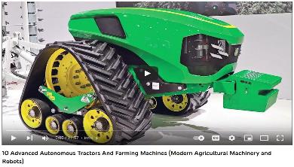
Innovative Technology
Technology and good ideas are helping farmers protect soil!
Using equipment differently can help. Tractors that have tracks instead of tires or that have less air in their tires do not press as hard on the soil.
Notes:
Innovative Technology
Work is being done to find a solution to soil compaction. Some of it is low tech — finding out how variably inflated tires and track-based agricultural machinery affect soil. Some of it is high tech — using drone mapping to monitor fields, using that digital mapping to spray only where it is needed, and using advanced seeders that can detect seeding depth. Let’s watch some a video to learn more!

Slide 13
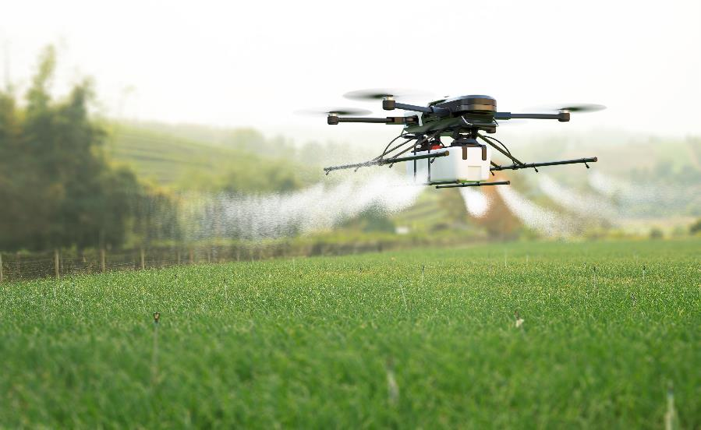
Innovative Technology
Technology and good ideas are helping farmers protect soil!
Drones flying over fields can make maps of the field to help farmers see where crops need more water or fertilizer. Special drones can do other jobs, too, such as spraying a crop.
Notes:
Innovative Technology
Work is being done to find a solution to soil compaction. Some of it is low tech — finding out how variably inflated tires and track-based agricultural machinery affect soil. Some of it is high tech — using drone mapping to monitor fields, using that digital mapping to spray only where it is needed, and using advanced seeders that can detect seeding depth. Let’s watch some a video to learn more!

Slide 14
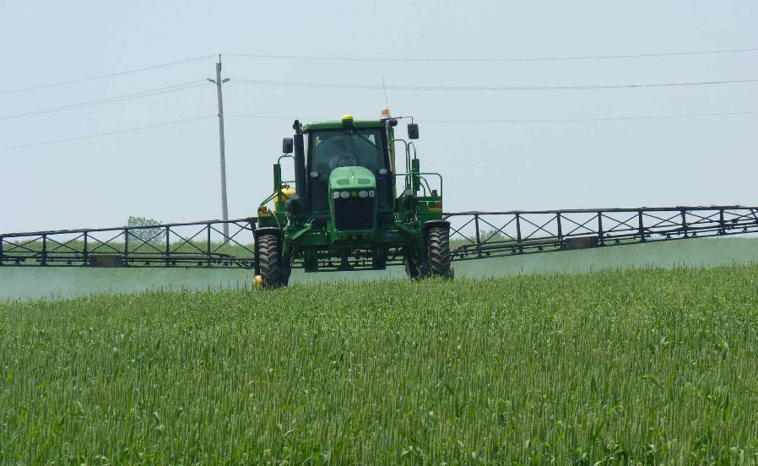
Innovative Technology
Technology and good ideas are helping farmers protect soil!
With a map made by a drone, a farmer can use GPS to send an auto-steer (self-driving) tractor into a field to only the places where needed.
Notes:
Innovative Technology
Along with digital mapping, farmers use GPS and auto-steer (self-driving) tractors to spray only where necessary, so they are not driving on every bit of their fields. https://canadianfoodfocus.org/on-the-farm/gps-helps-farmers-use-less-pesticides/

Slide 15
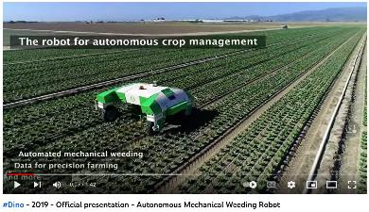
Innovative Technology
Technology and good ideas are helping farmers protect soil!
Check out the Dino Robot, a weeding machine tested in Canada.
Notes:
Innovative Technology
The Dino Robot is a weeding machine that has been tested in Canada: https://www.naio-technologies.com/en/news/large-scale-vegetable-weeding-in-canada-with-dino/ (Text is in English and French; videos are in French).

Slide 16
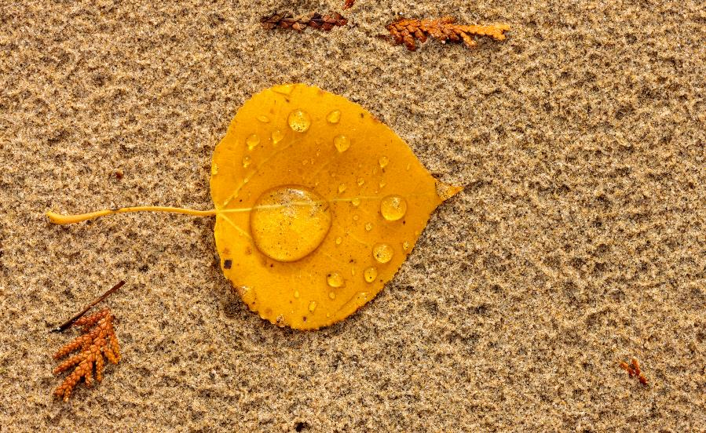
Investigating Soil Compaction
Minds on!
Let’s talk about how soil is affected by different things pressing on it. What do you notice?
Notes:
Investigating Soil Compaction
Minds on!
Let us talk about how soil is affected by different things pressing on it. Imagine being on a beach or in a garden and seeing where rain has pounded down on it. It looks like millions of fingers poked it. You may also see smooth spots where water pooled; water has weight, so a puddle presses down on the surface of the soil.
You can also see where your footprints have made an impression. That impression is soil compaction.

Slide 17
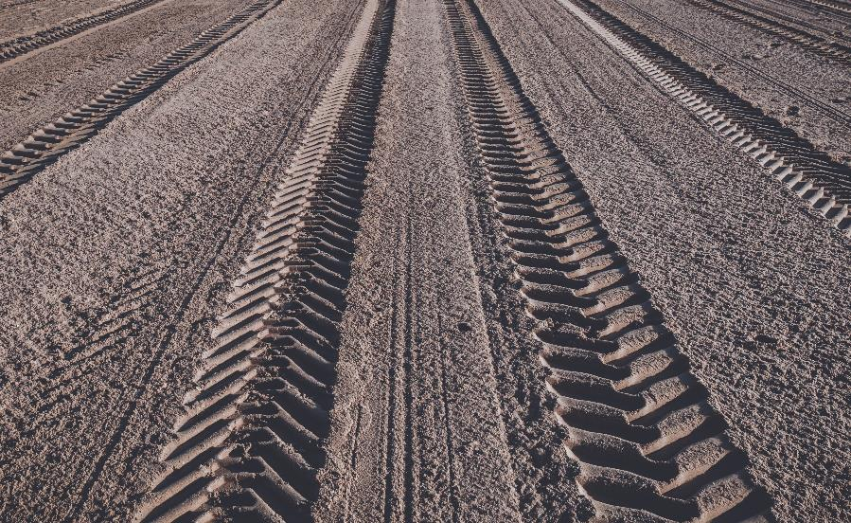
Investigating Soil Compaction
Ask
How much pressure does it take to compact the soil?
How long does pressure have to be applied to make a mark?
How can farmers change things? That’s a good question. Farmers are thinking of these things too.
Notes:
Investigating Soil Compaction
Ask:
How much pressure does it take to compact the soil?
How long does pressure have to be applied to make a mark?
How can farmers change things? That’s a good question. Farmers are thinking of these things too.
Extension activity you may want to try to investigate further.
Place a tennis ball in a tray of sand. Place a small piece of wood or sturdy cardboard on top as a platform and use it to roll the tennis ball across the tray. Examine the depth of the groove it created.
Students could repeat this process with different-sized balls or weights on the platform. Observe the effect changing the weight has on the depth of the groove.
Students could also investigate the effect of using different sized balls to simulate the effect of changing the size of the tire.

Slide 18
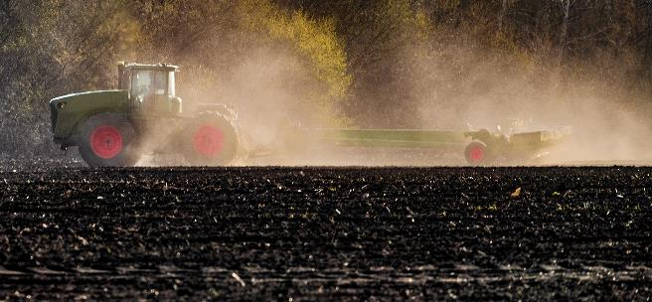
Erosion
Erosion is another way soil is affected; it happens when the top layer of soil is worn down and moved by wind or water.
When topsoil is dry, the wind can pick it up and carry it away. It takes away the nutrients that plants need to grow.
Notes:
Erosion
Erosion is another way soil is affected; it happens when the top layer of soil is worn down and transported by wind or water.
When topsoil is dry, the wind can pick it up and carry it away, taking with it the nutrients plants need to grow.

Slide 19
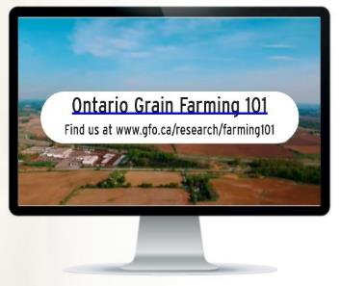
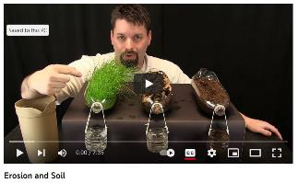
Erosion
In addition to washing the nutrients and topsoil away from fields, water erosion can also cause flooding. The soil is washed into nearby rivers.
This video shows the impact of plants on preventing soil erosion.
Many farmers help prevent erosion by planting cover crops, such as winter wheat. They help keep wind off the soil and their roots help hold the soil together.
Notes:
Erosion
In addition to washing the nutrients and top soil away from fields, water erosion can also cause flooding as the soil is washed into nearby rivers.
This video shows the impact of plants on preventing soil erosion: https://www.youtube.com/watch?v=im4HVXMGI68
Many farmers help prevent erosion by planting cover crops, such as radishes, clover, or winter wheat. They help keep wind off the soil and their roots help hold the soil together while they absorb water.

Slide 20
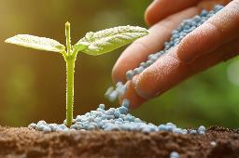
Nutrients
Farmers make sure nutrients the plants use are put back into the soil for the next crops.
Different crops need different nutrients.
Farmers apply fertilizers to their soil. Fertilizer puts back the nutrients that plants have used.
Fertilizer can be animal waste like manure or nutrients like nitrogen, phosphorus, or potassium, which exist naturally in soil.
Notes:
Nutrients
Different crops need different nutrients to grow.
As plants grow, they use the nutrients in the soil. If the same plants always grow in one spot, they will use up all the nutrients that type of plant needs and eventually, that type of plant cannot grow there anymore. Farmers have to make sure the nutrients the plants use are put back into the soil for the next crop.
Farmers apply fertilizers to their soil to put back the nutrients the plants have used. Farmers make sure they use only the amount necessary to help the soil and prevent excess fertilizer getting into waterways.
Fertilizer can be animal waste like manure or a blend of nutrients like nitrogen, phosphorus, or potassium, which are essential minerals found naturally in soil.

Slide 21
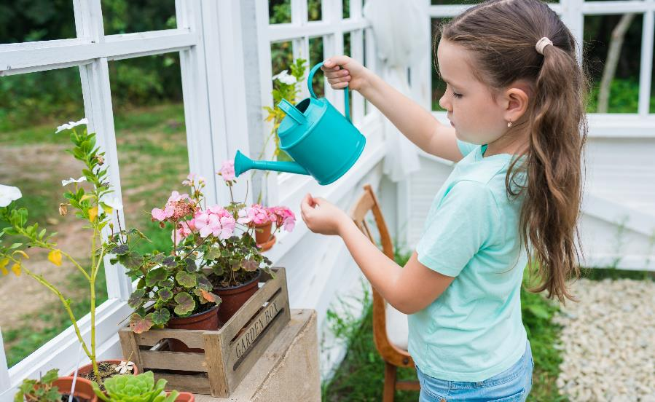
Investigating Soil Nutrition
We are going to investigate the effect of fertilizer on plant growth by growing three plants from seeds.
We will give each one a different amount of fertilizer and observe any differences in how the plants grow.
Notes:
Investigating Soil Nutrition
Students could conduct an investigation at this stage to determine the effect of fertilizer on plant growth by growing three plants from seeds, giving each one a different amount of fertilizer and observing differences in how the plants grow.
First, recap the concept of fair testing and remind the children that all variables (e.g., how much water or location in the classroom) must be kept the same. The only thing they should change is the amount of fertilizer they give each plant.
Students should choose which variables they measure (i.e., some may focus on speed of growth, the plants’ heights, or number of leaves.)
Different groups could grow different seeds to investigate to produce a range of results within the class.

Slide 22
Making a Fair Test
Think about how we set up a fair test with our other seeds.
The variable we are changing is the amount of fertilizer. This means we have to keep everything else the same.
We need to keep the amount of water and location in our classroom the same for each plant.
Notes:
Making a Fair Test
Students could conduct an investigation at this stage to determine the effect of fertilizer on plant growth by growing three plants from seeds, giving each one a different amount of fertilizer and observing differences in how the plants grow.
First, recap the concept of fair testing and remind the children that all variables (e.g., how much water or location in the classroom) must be kept the same. The only thing they should change is the amount of fertilizer they give each plant.
Students should choose which variables they measure (i.e., some may focus on speed of growth, the plants’ heights, or number of leaves.)
Different groups could grow different seeds to investigate to produce a range of results within the class.

Slide 23
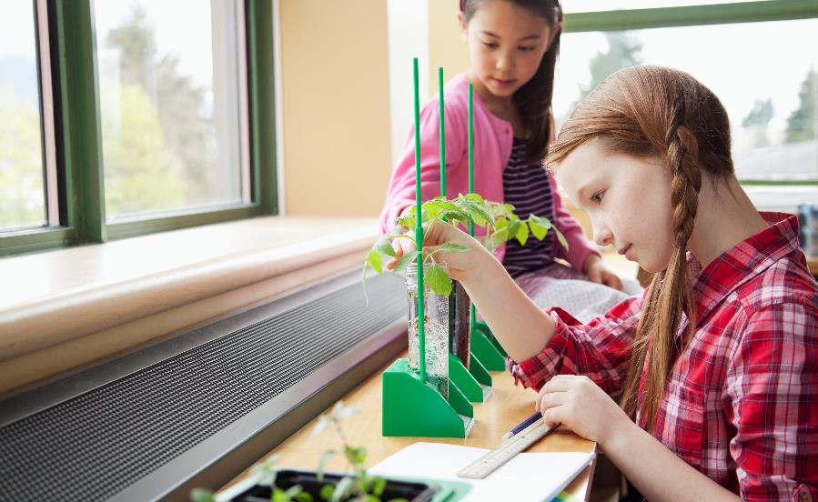
Measuring the Plants’ Growth
As a group you will need to decide what you are going to measure while your plant is growing.
Will you investigate:
How fast the plants are growing?
How high the plants are growing?
The number and colour of leaves.
Remember to make your prediction.
Notes:
Measuring the Plants’ Growth
Students could conduct an investigation at this stage to determine the effect of fertilizer on plant growth by growing three plants from seeds, giving each one a different amount of fertilizer and observing differences in how the plants grow.
First, recap the concept of fair testing and remind the children that all variables (e.g., how much water or location in the classroom) must be kept the same. The only thing they should change is the amount of fertilizer they give each plant.
Students should choose which variables they measure (i.e., some may focus on speed of growth, the plants’ heights, or number of leaves.)
Different groups could grow different seeds to investigate to produce a range of results within the class.

Slide 24
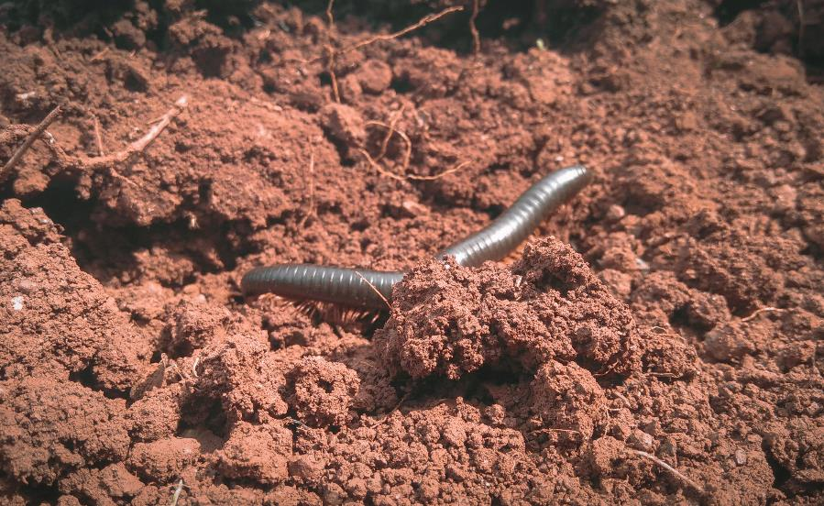
Investigating Soil Biodiversity
Worms are an excellent indicator of soil health.
The more worms there are in the soil, the healthier it is.
We are going to find two different areas of soil and cut out two equal sized pieces.
Count the number of worms in each location.
Which area had the healthiest soil?
Notes:
Investigating Soil Biodiversity
A final investigation for students is a worm survey.
The number of worms in a soil sample is an indication of soil health. Students could cut out two equally sized squares of earth from different places (school, home) and count the number of worms.
Each group could display their worm counts on a bar graph.

Slide 25
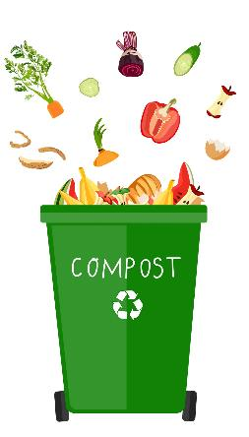
Composting
We can help make healthy soil for our gardens by composting our food waste.
We will make a mini composter in class so we can see how the food breaks down into healthy soil.
Add some organic waste (potato peel, apple core, etc) to a large bottle with a little soil in. Put the bottle in direct sunlight and watch the changes inside the bottle over time.
Notes:
Composting
Alternative/extension activities could include:
Making a mini composter using a 2 L bottle containing soil and organic waste and leaving it in direct sunlight for 8 weeks.
Investigate the benefits of composting and design a poster about why it is important to your city and the food you eat.

