Slide 1
Stage 3 - Growing Our Ingredients From Seeds
© The National Farmers’ Union of England and Wales - All rights reserved. These resources may be reproduced for educational use only.

Slide 2
Learning Objectives
Notice that plants have distinct characteristics.
Identify similarities and differences among the various types of plants grown.
Understand the basic needs of plants and energy.
Consider different ways plants are grown for food.
Discuss examples of environmental conditions that may threaten plant and animal survival.
Notes:
Learning Objectives
Notice that plants have distinct characteristics.
Identify similarities and differences among the various types of plants grown.
Understand the basic needs of plants and energy.
Consider different ways plants are grown for food.
Discuss examples of environmental conditions that may threaten plant and animal survival.

Slide 3
Let’s Recap the Last Session
We learned:
As a group, make up two truths and a lie about where plants come from or where seeds come from.
Present your two truths and a lie to the other groups to see if they’ll make a mistake.
Notes:
Let’s Recap the Last Session
Ask students to discuss the questions on the presentation with their business groups to recap their learning from stage 1: Where do Plants Come From? Where do seeds come from?

Slide 4
Growing Plants From Seeds
We are going to grow the plants we will need for our granola bars.
Inside each seed is everything they need to make a new plant… but they need the right conditions to grow.
We will keep a journal during our investigation to see which of our plant ingredients will grow fastest and win the Great Ingredient Race!
Notes:
Growing Plants From Seeds
Explain: We are going to grow our own plant ingredients from seeds so we can see our plant learning coming to life in the classroom.
Explain: Seeds are little packages of life. Inside them is everything needed to make a new plant under the right conditions.
We will keep a journal and conduct an investigation to see which of our plant ingredients will grow fastest and win the great ingredient race!

Slide 5
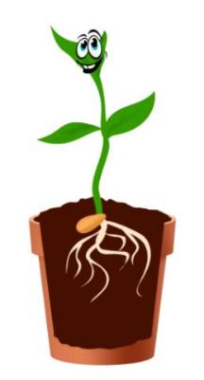
What Do Plants Need?
Just like humans, plants need certain things to grow and be healthy.
Can you think of any?
We will learn all about this so we can grow all our own plant ingredients for our granola bar business.
Notes:
What Do Plants Need?
Explain: Just like humans, plants need certain things to grow and be healthy. Ask the children if they can think of any things plants need. Create a list on the Wonder Wall or a whiteboard.

Slide 6
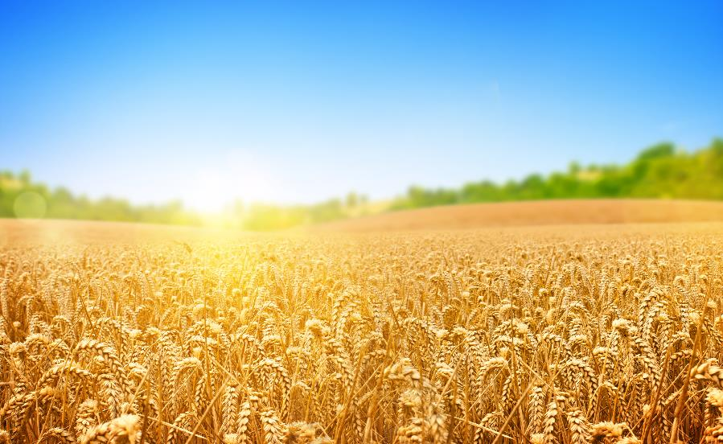
Light
Plants need light to grow and be healthy.
Plants are amazing! They can turn sunlight and water into their own food in their leaves during a process called photosynthesis.
We also need sunlight to help our bodies make Vitamin D to keep us healthy.
Notes:
Light
Talk through the presentation to explain the conditions plants need in more detail:
Plants need light to grow and be healthy.
Plants are amazing! They can turn sunlight and water into food in their leaves during a process called photosynthesis.

Slide 7
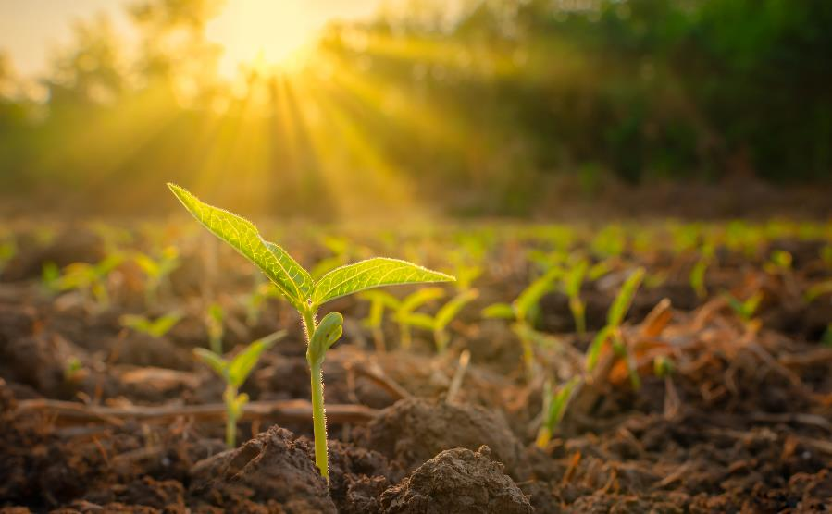
Photosynthesis
During photosynthesis, plants use sunlight to turn water and carbon dioxide into nutrients to keep them healthy.
Photosynthesis also releases oxygen; the gas humans and animals need to breathe.
Notes:
Photosynthesis
During photosynthesis, plants use sunlight to turn water and carbon dioxide into nutrients to keep them healthy. Photosynthesis also releases oxygen, the gas that humans and animals need to breathe.

Slide 8
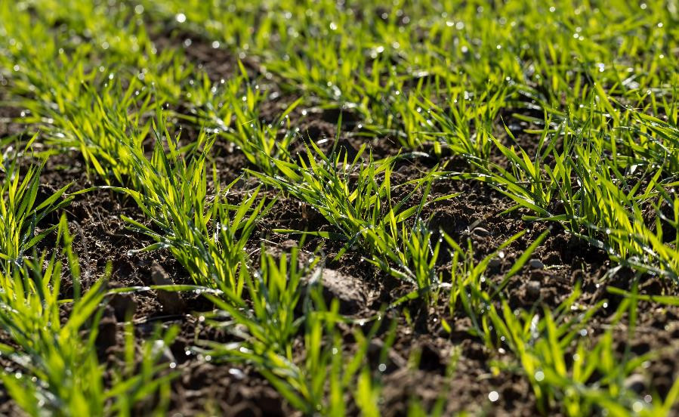
Water
Just like us, plants need water. Without the right amount of water, plants cannot grow and be healthy.
At the start of a plant’s life, it needs water to make it grow into a little seedling.
Once the seedling has grown roots, it needs water to take up nutrients out of the soil. Nutrients are healthy things that help the plant grow.
Notes:
Water
Just like us, plants need water. Without the right amount of water, plants cannot grow and be healthy.
At the very start of a plant’s life, it needs water to make it start to grow into a little seedling.
Once the seedling has grown some roots, the plant needs water to take up the nutrients out of the soil. Nutrients are the things plants need to grow.

Slide 9
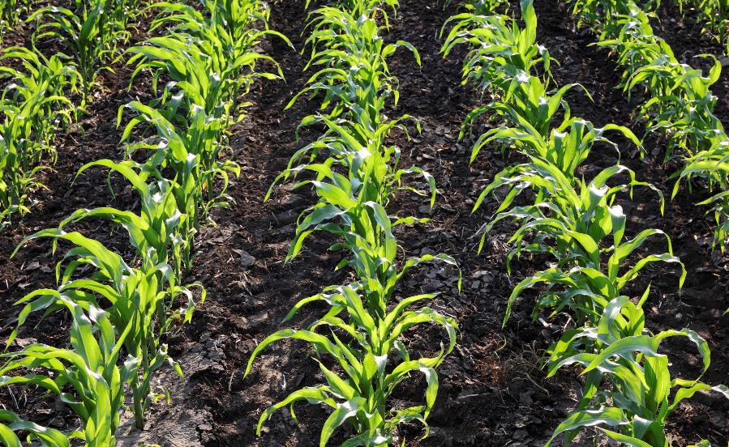
Not Enough Water
Water is very important to farmers.
If there is not enough rain, their crops will not grow properly.
Some farmers irrigate (water) their crops during the growing season. Others rely on rainfall to get enough water for their plants to grow. Here in Ontario, most farmers rely on rain.
Notes:
Not Enough Water
Water is very important to farmers. If there is not enough rain, their crops will not grow properly.
Some farmers irrigate (water) their crops during the growing season. Others rely on rainfall to get enough water for their plants to grow. Here in Ontario, most farmers rely on rain.

Slide 10
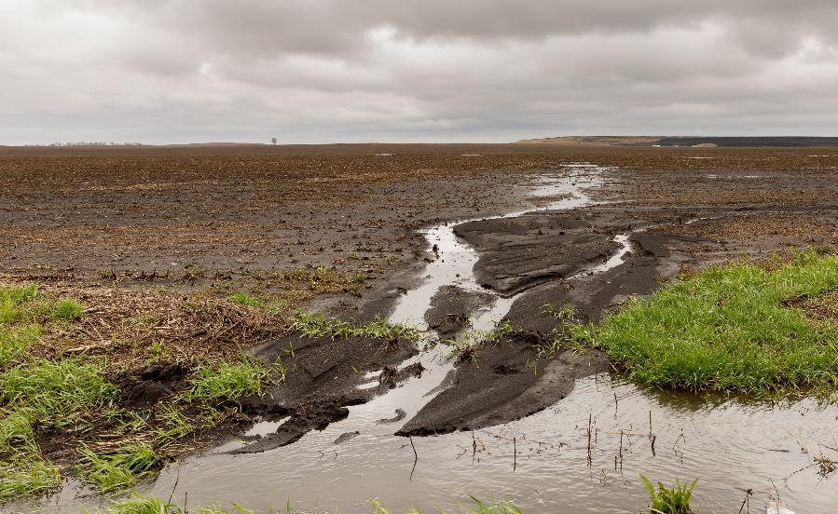
Too Much Water
Too much water is also a big problem for farmers.
Flooding or heavy rainfall can affect the health of soil because it washes away some of the soil particles and nutrients that plants need to grow and be healthy.
Notes:
Too Much Water
Ask students what they think will happen if plants have too much water.
Too much water is also a big problem for farmers.
Flooding or heavy rainfall can affect the health of soil because it washes away some of the soil particles and nutrients that plants need to grow and be healthy. Flooding can also drown plants in the fields so they can not grow.

Slide 11
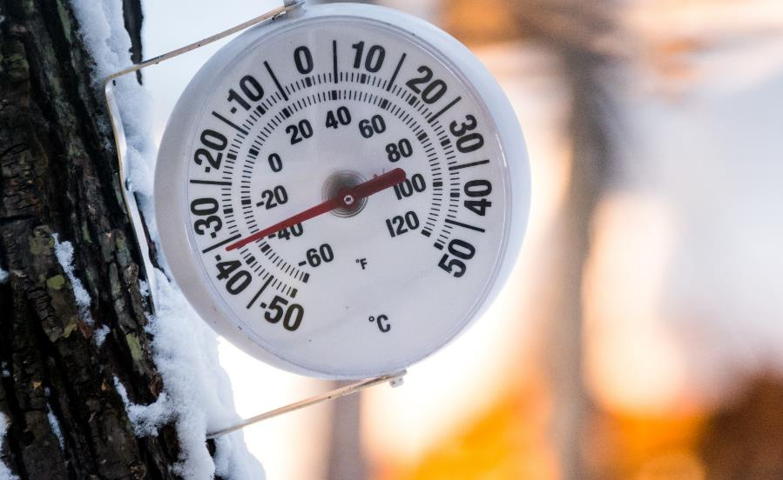
Temperature
How do you feel if you get too cold or too hot? What do you do about it?
Just like us, plants need a suitable temperature to be healthy. They will not start to grow from seeds if their environment is not the correct temperature.
Notes:
Temperature
Ask the children to think about how they feel if they get too cold or too hot and what they do about it.
Just like us, plants need a suitable temperature to be healthy. They will not start to grow from seeds if their environment is not the correct temperature.

Slide 12
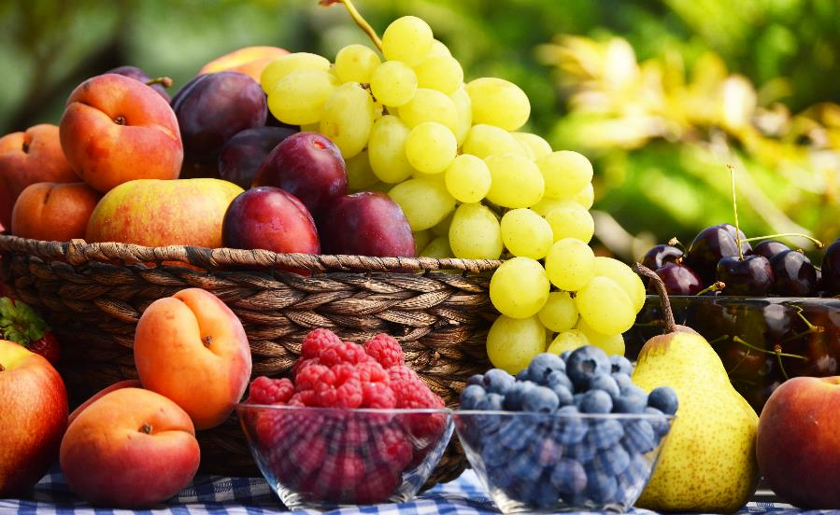
Grown in Ontario
Different plants need different temperatures to grow, which is why we can grow certain foods in Ontario but not all plants.
Eating food grown in Ontario is one way we can care for the environment. When food does not have to travel very far to reach our plates, it takes less fuel, which reduces air pollution.
Notes:
Grown in Ontario
Explain that different plants need different temperatures, which is why we can grow certain foods in Ontario but not all plants.
Some plants need different conditions such as a different climate.
Some plants need different conditions to survive such as bananas, which need a tropical temperature.
Explain: eating food grown in Ontario is one way we can care for the environment. When food doesn’t have to travel very far to reach our plates, it takes less fuel, reducing air pollution.

Slide 13
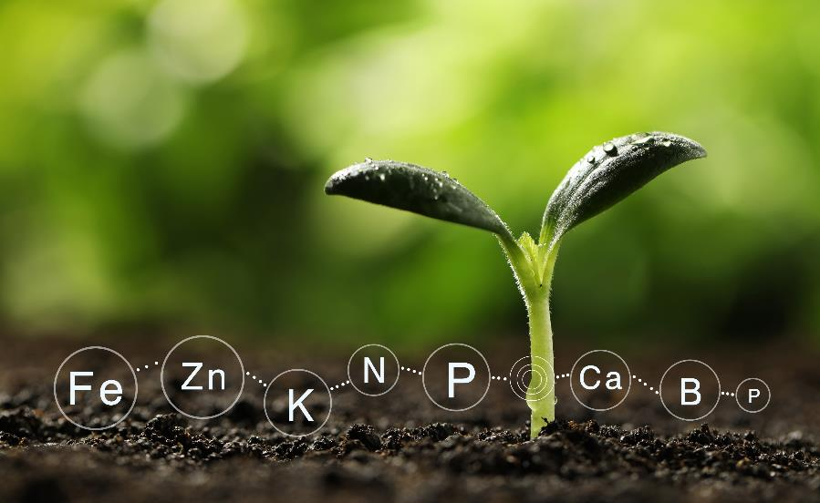
Nutrients
Plants take their nutrients from their soil, so it is very important that farmers keep their soil healthy. We will learn all about this later in the project.
Notes:
Nutrients
Plants take their nutrients from the soil so it is very important that farmers keep their soil healthy. We will learn all about this later in the project.

Slide 14
A Fair Test
A fair test is a controlled investigation that compare two things. For a test to be fair or well-controlled, we must make sure that only one thing (called a variable) is changed and everything else is kept the same.
Notes:
A Fair Test
Use the presentation to discuss the meaning of a fair test and why it is important.
A fair test is a controlled investigation that compares two things. For a test to be fair or well-controlled, we have to make sure that only one thing (called a variable) is changed and everything else is kept the same.

Slide 15
Variables
A variable is anything that can affect the results we are observing or measuring.
In our investigation, we will use two different seeds. This is the variable we are changing. We will treat both of our seeds exactly the same and observe what happens.
What variables do we need to keep the same as we look after our young plants?
Notes:
Variables
A variable is anything that can affect the results we are observing or measuring.
In our investigation, we will use two different seeds. This is the variable we are changing.
Then we will treat both of our seeds exactly the same and observe what happens.
Ask students what variables we need to keep the same as we look after our young plants. Possible answers are type of compost, planting depth, amount of water, size of pot, position in classroom (to keep light and temperature constant).

Slide 16
Make a Prediction
Which plant do you think will grow fastest? Why?
Which plant do you think will grow tallest? Why?
Write down your prediction.
Notes:
Make a Prediction
Ask students to predict which ingredient they think will grow the fastest/tallest and why.

Slide 17
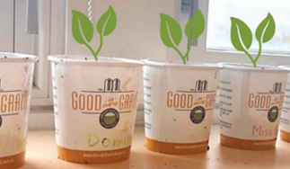
Planting Your Seeds
Once you have planted your seeds, think about how you will keep your experiment fair.
How much water will you give the seeds? How are you going to measure this? How often will you water the seeds?
Where is the best place in your classroom to keep the plants?
Remember to label your plants so you know which pot is which.
Notes:
Planting Your Seeds
Model planting each of the ingredient seeds.
Model measuring water accurately and agree on a standard volume of water to give to each seed.
Discuss the best place in the classroom to keep the plants to help them grow.
Educators can order free seed kits to use with this step. While supplies last at https://goodineverygrain.ca/ontario-farming-stemterprise/

Slide 18
Observational Journals
You are going to keep a seed journal. Each time you water your plants, observe them and record any differences you notice.
Include a diagram for each of your journal entries.
Bonus! Take a picture of your plants each day to create a time lapse video of your plant’s growth.
Notes:
Observational Journals
As their plants grow, ask students to complete a regular ingredient diary using the activity sheet.
Students should be encouraged to observe their plants closely and draw detailed, labelled diagrams at each stage.
Model measuring length accurately and ask the children to record the height of their plants at each stage.
Use the presentation to teach the appropriate scientific vocabulary to label and describe their diagrams .
Students could also take a photo each day to create a time lapse video of their plants’ growth.

Slide 19
Conclusions
Once your plants have grown, consider these questions:
Explain what you found and why you think it happened.
Was your prediction correct?
Which ingredient grew fastest?
Which ingredient grew tallest?
What did you notice about the directions the plants grew?
Was your investigation a fair test?
How could you improve it next time?
Notes:
Conclusions
Once the plants have grown ask the children to consider the questions on the presentation:• Explain what you found and why you think it happened.
• Which ingredient grew fastest?
• Which ingredient grew tallest?
• What did you notice about the directions the plants grew?
• Was your investigation a fair test?
• How could you improve it next time?

