Slide 1
Stage 2 - Setting up a Business
© The National Farmers’ Union of England and Wales - All rights reserved. These resources may be reproduced for educational use only.

Slide 2
Learning Objectives
Design a brand and logo.
Understand the importance of a healthy balanced diet.
Analyze existing products in the market.
Notes:
Learning Objectives
Design a brand and logo.
Understand the importance of a healthy balanced diet.
Analyze existing products in the market.

Slide 3
Let’s Recap the Last Session
We learned:
Each time you catch the ball, share a fact you remember about grains or parts of the plant from last lesson with your group.
Which group can keep listing facts the longest?
Notes:
Let’s Recap the Last Session
• In small groups, ask students to throw a tennis (or similar) ball to each other. Each time they catch it, they have to share a fact they remember about grains or parts of the plant from last lesson.
• Alternatively, you could use a vertical relay game to revise the last lesson’s content.
• Prompt students to remember everything they can about parts of a plant, their uses, grains, their nutritional benefits, and the environmental benefits of eating locally sourced ingredients.

Slide 4
Analyzing the Competition
We are going to taste test some of the granola bars already available to buy so you can assess your competition and think of ways to convince customers to try your new granola bars instead.
Talk to your partner: what features of granola bars should we analyze?
Notes:
Analyzing the Competition
Explain to students they will taste test some of the granola bars already available to buy so they can assess the competition and think of ways to improve the granola bars.
Ask for suggestions on what they should analyze. Some examples could be texture, flavour, size, moisture, shape, smell.
Hand out the Granola Bar Marketing Strategy sheets (one per group or per student).

Slide 5
Taste Testing
You will be given a small piece of bars A - E. Your task is to fill in the table to rate them out of five on the variables we have agreed on.
Granola bar/ variable | Taste | Texture | Shape | Size
A
B
C
D
E
Notes:
Taste Testing
Take the granola bars out of their packaging, cut them into small pieces (enough for one for each child), and place them on the far left of their Granola Bar Marketing Strategy sheet.
After the bars have been distributed, ask them to rate it out of five on the agreed variables.
Ask the students to expand on their ratings with comments and guess which grain they think has been used in each bar. What other ingredients can they taste?
Repeat the exercise with the remaining four bars.

Slide 6
Evaluation
Share your evaluations with your business group.
What features might you like to take inspiration from? What features can you improve on?
Notes:
Evaluation
Ask the business groups to share their evaluations and discuss any initial ideas they have for improving the bars to make them really appealing to students (e.g., they might like to create a new shape or use a combination of the flavours they’ve just tried).

Slide 7
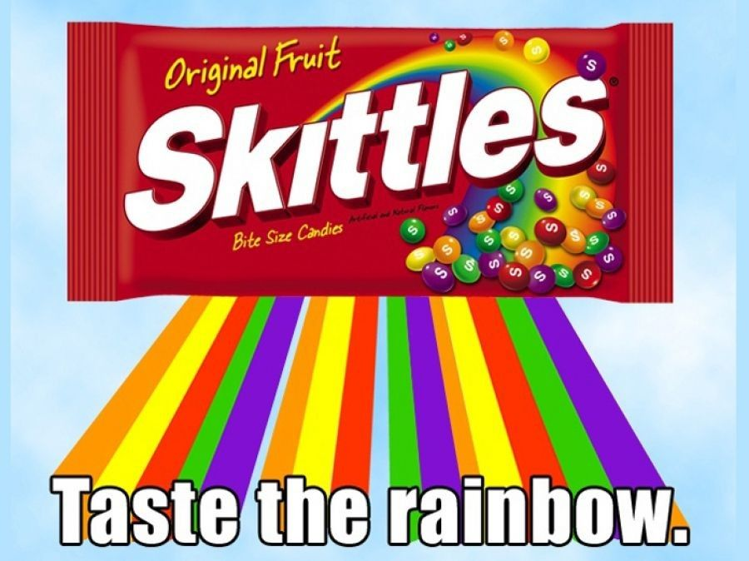
Naming your Business
One way for your business to stand out is to create a strong brand with a memorable logo.
Work in your groups to think of a name for your business.
You might incorporate some nutritional benefits into your name
You might think of a clever slogan
Notes:
Naming your Business
Explain to students that the Marketing Strategy sheets can be added to whenever students have ideas they want to remember. Some parts of the worksheets will be completed in later stages of the project (ex. Profit)

Slide 8
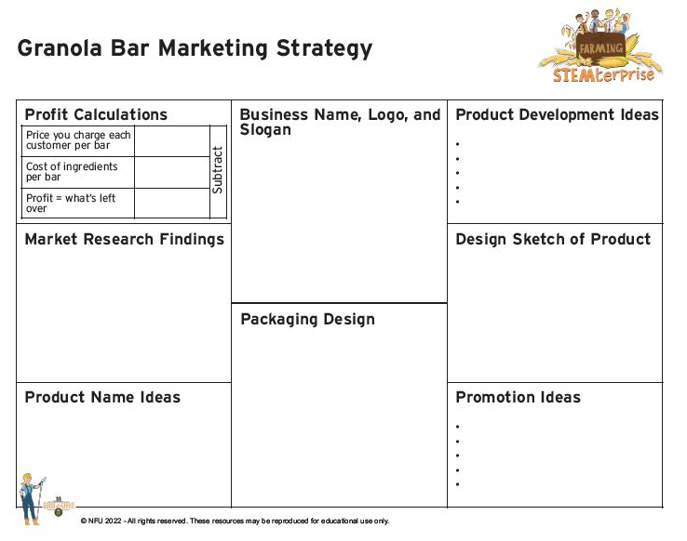
Designing a Logo
Think about some of the logos you are familiar with. They are often very simple, but memorable designs.
Design your business’s logo on your marketing strategy activity sheet.
Notes:
Designing a Logo
Ask students to think of a name for their business and design a striking logo using the top tips on the PowerPoint presentation which can be recorded on the marketing strategy sheet.
Suggest that they might like to incorporate some nutritional benefits into their name (e.g., Energy Bites, Fi-bar) or perhaps a reference to the locally sourced ingredients.
They might like to think of a clever slogan such as “Power your brains with grains”.
Explain to students that the Marketing Strategy sheets can be added to whenever students have ideas they want to remember. Some parts of the worksheets will be completed in later stages of the project (ex. Profit)

