Slide 1
Stage 1 - Becoming a Plant Expert
© The National Farmers’ Union of England and Wales - All rights reserved. These resources may be reproduced for educational use only.

Slide 2
Learning Objectives
Discuss where food comes from.
Explore the many roles of plants in our lives.
Identify and describe the major parts of plants, including root, stem, flower, stamen, pistil, leaf, seed, and fruit, and each one’s contribution to the plant’s survival.
Notes:
Learning Objectives
Discuss where food comes from.
Explore the many roles of plants in our lives.
Identify and describe the major parts of plants, including root, stem, flower, leaf, seed, and fruit and each one’s contribution to the plant’s survival.

Slide 3
Wonder Wall
What would you like to know about your food and where it comes from?
Write your questions down and add them to our Wonder Wall.
We will find the answers to your questions during this project.
Notes:
Wonder Wall
Ask students to consider what they would like to know about their food and where it comes from.
Ask them to write down their question(s) and add it to the Wonder Wall or in their notebooks. Explain that we will answer their questions during the project.

Slide 4
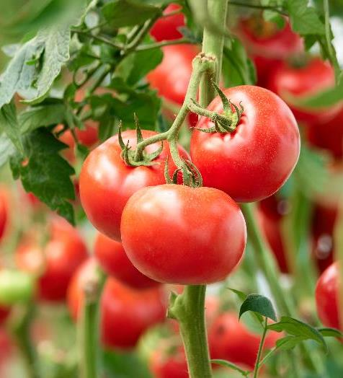
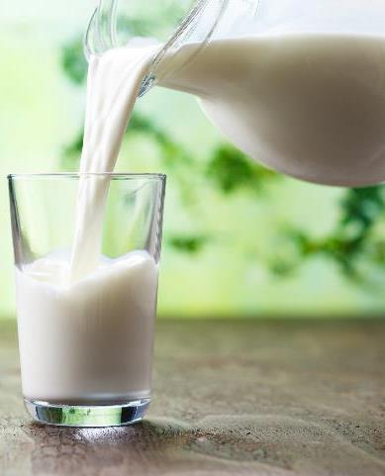
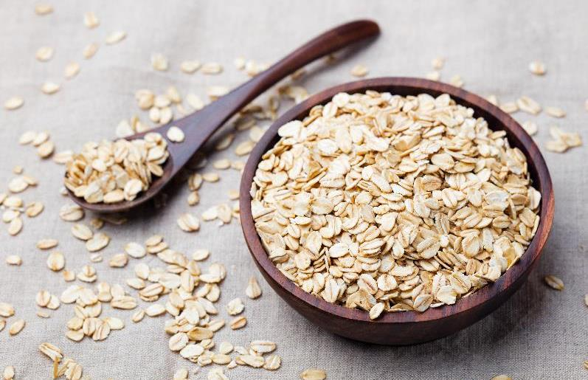
One is Different
Look at these photos.
Talk with your partner about which one is different from the others. Why?
There are many possible answers.
Notes:
One is Different
Share the three photos of food (milk, oatmeal, and tomatoes). Have students talk in pairs and explain which is different from the others.
Take feedback and explain that there are many possible answers. It could be milk is the different one because it comes from a cow, whereas the other food ingredients can be grown from plants.

Slide 5
Where Does Our Food Come From?
Let’s learn about grains! They are a special type of plant used as ingredients in many foods.
Oats are a kind of grain. Farmers plant oat seeds in soil and once the plants are grown, they harvest them with a large machine called a combine harvester.
Can you think of other foods that are made from oats?
Notes:
Where Does Our Food Come From?
Explain: During this project, we will learn about grain, a special type of plant we use for food. Grains are ingredients in many foods. Which of the three foods on the previous slide is a grain food?
Oatmeal is made from oats, a kind of grain. Farmers plant oat seeds in soil, and once the plants are grown and ready to be harvested, they harvest them with a large machine called a combine harvester (or “combine”).
Ask students to think of other foods made with oats, such as granola bars.

Slide 6
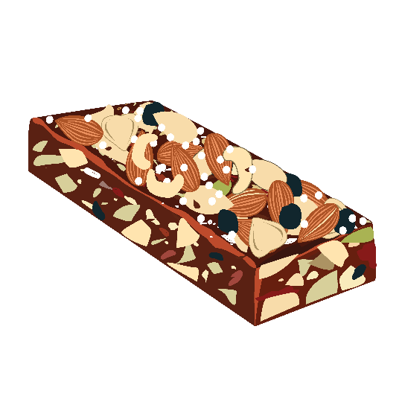
Your Challenge!
Ontario children need an exciting, innovative new snack option. In this project, you will design a brand-new granola bar to fuel our bodies for learning!
We will learn how to set up a granola bar business.
Step One: Become a plant expert. Your specialty will be grains, used as the main ingredient in granola bars.
Notes:
Your Challenge!
Ontario farmers grow many types of grains. Oats grown in Northern Ontario are best suited to making granola or snack bars. But oats grown in Southern Ontario are better for other uses. Eating food made with locally grown ingredients means our food does not have to travel as far to reach our plates. Ask the students how this helps the environment.
Set the scene: Ontario children are bored with their current snack choices. They need an exciting, innovative new option. In this project, they will design a brand-new granola bar to fuel our bodies for learning!
Explain: Students will learn how to set up a granola bar business. Perhaps they will grow up to become entrepreneurs with businesses of their own!
Step One is to become a plant expert specializing in grain.

Slide 7
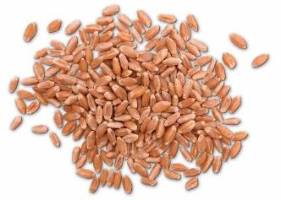
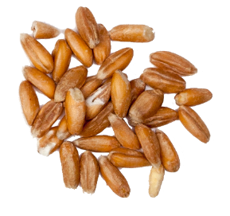
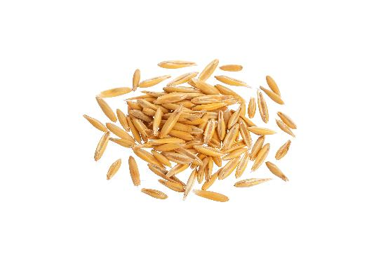
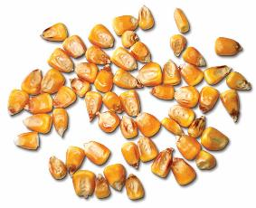
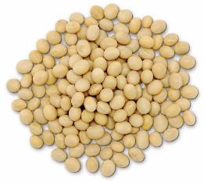
Grains
How many types of grains can you and your partner think of? Here in Ontario, we grow lots of different grains.
Notes:
Grains
Ask students to name as many types of grain as they can. Share the full list of grains grown in Ontario in the PowerPoint presentation.
Give each business group a type of grain to become experts in and allot five minutes to research food products that contain their grain.
Allow another five minutes to research the health benefits of eating grains.
Give each group one minute to summarize their findings for the rest of the class.

Slide 8
Barley
Farmers grow barley by planting seeds in soil. The seeds are also the grains we use to make food. Barley is mostly used to make beer, a type of drink for adults. It can also be ground into flour and used to make flatbread and breakfast oatmeal.
Barley plants can also be used to make food for farm animals, while the plant stems can be used as bedding for these animals.
Notes:
Barley
Share the PowerPoint presentation slides to learn more about the grains grown in Ontario.

Slide 9
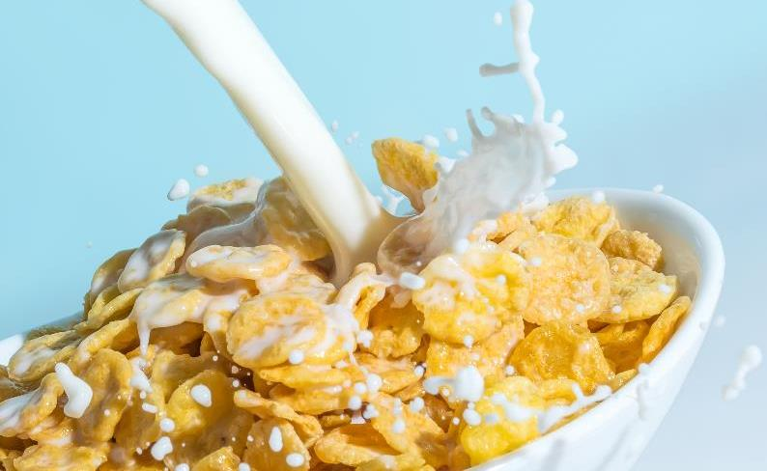
Corn
Farmers grow corn by planting seeds in soil. The seeds are the kernels on the cob. There are many types of corn used in different ways. Farmers harvest the seeds (or kernels) differently depending on what they will be used for.
Most corn grown in Ontario is grain corn. We use it to feed animals, and to make other things like cereal, gasoline, diapers, and toothpaste.
Notes:
Corn
Share the PowerPoint presentation slides to learn more about the grains grown in Ontario.

Slide 10
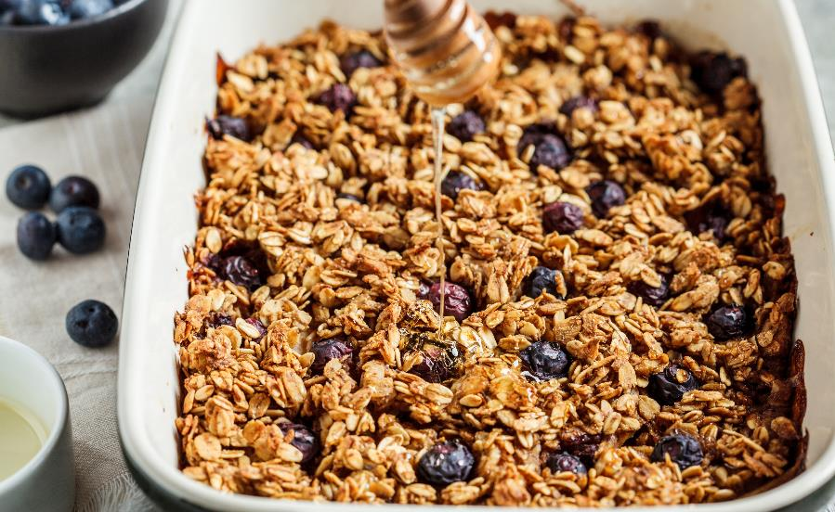
Oats
Farmers plant oat seeds in soil to grow into plants. When plants are fully grown and ready for harvest, the farmer harvests them with a big machine called a combine harvester or combine for short.
Oats are processed and made into food products such as oatmeal, pancakes, and granola bars. Oat plants feed farm animals and stems are used for bedding on farms.
Notes:
Oats
Share the PowerPoint presentation slides to learn more about the grains grown in Ontario.

Slide 11
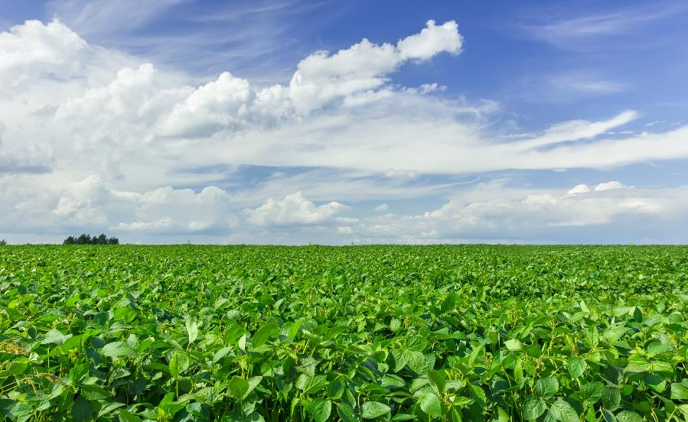
Soybeans
Farmers plant soybean seeds in the soil. The seeds are the beans found in the pod. When they change from green to brown, they are fully grown plants. Then the farmer harvests the soybeans with a combine harvester.
We make lots of different things from soybeans, like tofu, soy drinks, mayonnaise, crayons, and even candies!
Notes:
Soybeans
Share the PowerPoint presentation slides to learn more about the grains grown in Ontario.

Slide 12
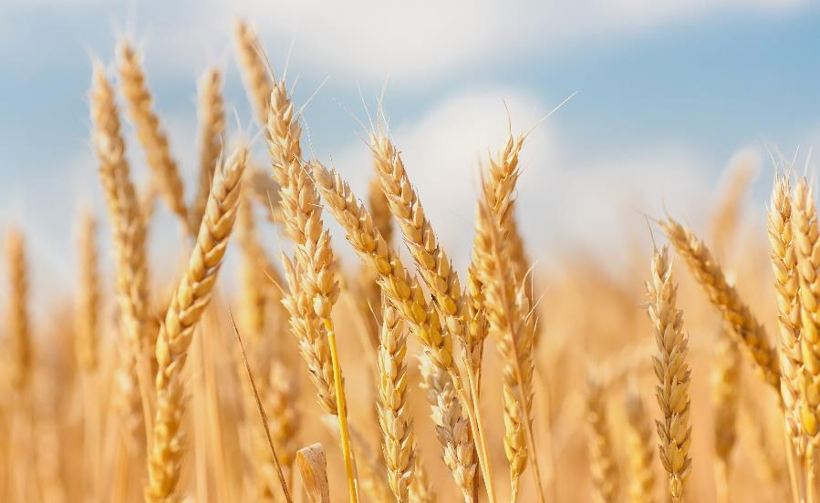
Wheat
Farmers plant wheat seeds in the soil and then look after the plants for almost a whole year before the wheat can be harvested.
At harvest time, wheat grains are sent away to a mill to be ground into flour. The flour can be used to make lots of foods such as bread, pasta, and cookies. Parts of the wheat plant are used as straw for animal bedding.
Notes:
Wheat
Share the PowerPoint presentation slides to learn more about the grains grown in Ontario.

Slide 13
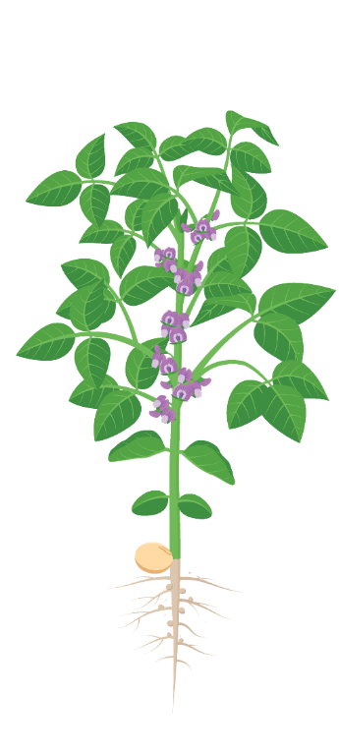
Vertical Relay
We need to become plant experts to have a successful business making granola bars! We must know how to grow, nurture, and harvest the plant ingredients we need.
Let’s find out what we already know about the parts of a plant!
Notes:
Vertical Relay
Explain: We must know how to grow, nurture, and harvest the plant ingredients we need for our granola bars.
Display the unlabelled flowering plant diagrams around the classroom/ outside space (one for each business group).
Ask students to stand in a line in front of their group’s diagram.
Explain: When you say “go,” they will label the diagrams with any information they already know.
Each child may add one piece of information before passing the pen to the next child (like a relay baton), and going to the end of the line. Encourage students to work as a team and help each other.
Explain: This is a race and the teams are competing to be first to label the whole diagram correctly with as much information as possible. Be clear that it does not matter if they do not know the answers yet. They will know them by the end of the lesson.
Allow time for the business groups to share their answers with the rest of the class. Address any misconceptions and share the names of the parts of the plant in the presentation.

Slide 14
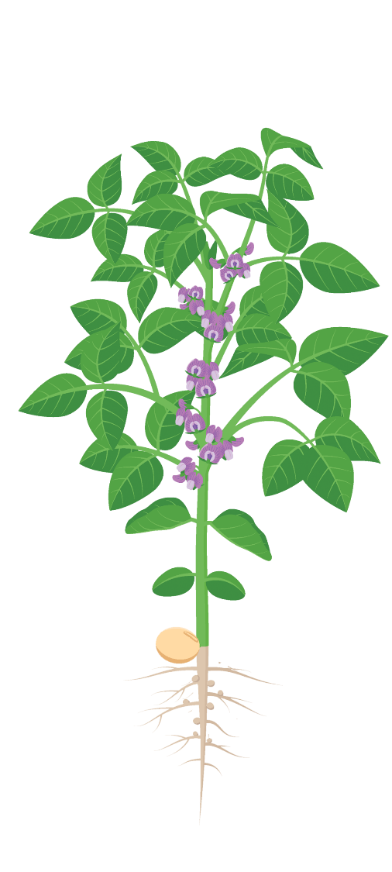
Parts of a Plant
How many parts did you label correctly?
Bud
Flower
Leaf
Stem
Seed
Root
Notes:
Parts of a Plant
How many parts did you label correctly?

Slide 15
Plant Research
We are going to find out more plant facts and learn about jobs that each part of a plant does!
Work in your business groups to research one part of a plant, its functions and uses.
You will need to work as a team to ensure that facts are not repeated.
This is a challenge to collect as much good quality information as you can!
Notes:
Plant Research
Explain: We are going to learn even more about the jobs that each part of a plant does.
Give each business group an area to focus on during their research (root, stem, flower, leaf, seed, and fruit).
Challenge the groups to research the functions of their part of the plant and some of their uses using several sources (e.g. nonfiction books, the internet, and the information sheets provided.
Give each group a different colour of Post-it notes. Ask them to write each new fact on a Post-it note and run to the other end of the classroom/outside area to stick it on a display.
They will need to work as a team to ensure facts are not repeated. Suggest each student use different source of information as they can.
Explain: The challenge is to collect as much good quality information as they can. The Post-it notes will create a visual demonstration of which teams have been most successful.

Slide 16
Presenting your Research
Your team will now have two minutes to summarize and present all your findings for the rest of the class.
Notes:
Presenting your Research
Once teams have collected enough research, give each team two minutes to summarize and present their findings for the rest of the class.
To reinforce the learning, you could ask the students to visit the display they have created and make their own notes on all parts of the plant using the facts their peers have found.

Slide 17
Roots
They act as an anchor to hold the plant in the soil.
They take up water and dissolved minerals from the soil.
Can you think of any examples of plant roots that we eat?
Root
Notes:
Roots
Use the PowerPoint presentation slides to cover the functions of the basic parts of the plant. Address any misconceptions identified during the research and vertical relay tasks.

Slide 18
Leaves
Plants need leaves to make their own food.
Leaves trap energy from the sun to produce sugars. The plant breaks down these sugars to give it energy. This process is called photosynthesis.
Can you think of any examples of plant leaves that we eat?
Leaf
Notes:
Leaves
Use the PowerPoint presentation slides to cover the functions of the basic parts of the plant. Address any misconceptions identified during the research and vertical relay tasks.

Slide 19
Stems
They hold leaves and flowers above ground so leaves can get sunlight and flowers can attract insects.
They help to transport minerals and water from the roots to the rest of the plant. They help to carry sugars away from the leaves.
Can you think of any examples of plant stems we eat?
Stem
Notes:
Stems
Use the PowerPoint presentation slides to cover the functions of the basic parts of the plant. Address any misconceptions identified during the research and vertical relay tasks.

Slide 20
Flowers
They are often brightly coloured and smell attractive to insects. Insects help to pollinate plants, a very important part of plant reproduction.
Flowers make the seeds that will grow into new plants.
Can you think of any examples of flowers we eat?
Flower
Notes:
Flowers
Use the PowerPoint presentation slides to cover the functions of the basic parts of the plant. Address any misconceptions identified during the research and vertical relay tasks.

Slide 21
Seeds
Seeds are tiny packets of new life. Plants need seeds to reproduce or make more of themselves.
We will learn all about how plants make them later on in the project.
Can you think of any examples of seeds we eat?
Seeds
Notes:
Seeds
Use the PowerPoint presentation slides to cover the functions of the basic parts of the plant. Address any misconceptions identified during the research and vertical relay tasks.

Slide 22
Vertical Relay
Let’s find out much you have learned about the parts of a plant and their functions in today’s lesson.
Notes:
Vertical Relay
Repeat the vertical relay activity.
This time, the students should be able to complete the activity more confidently using what they have learned.
Encourage them to fill the diagrams with all their learning from the lesson.

Slide 23
Wonder Wall Recap
Have we answered any of your questions today?
Notes:
Wonder Wall Recap
Refer back to the students’ Wonder Wall questions. Have they answered any of them yet? If they have, ask them to add the answer in a different color.
Refer to the Wonder Wall regularly during the project. Allow time for students to add the answers they have discovered and more questions.

